Slide 1
Predictis
CSE - 5805
Machine Learning I
Final Project Presentation
-By Shutonu Mitra

Slide 2
Predictis
Phase 1: Data Preprocessing & EDA
Phase 2: Regression Analysis
Phase 3: Classification
Phase 4: Clustering
Outline

Slide 3


Predictis
Problem Statement
This project aims to evaluate the health effects on smokers and individuals with frequent drinking habits.
It provides insights into their smoking and drinking patterns compared to regular users.
The goal is to empower them to make informed choices to reduce their alcohol or tobacco consumption.
It is also possible to investigate the health impact on individuals exposed to secondhand smoke and those who do not frequently consume alcohol, including children.
A Medical Decision Making Daignosis System

Slide 4
Predictis
Dataset Description
Dataset Name: Smoking and Drinking Dataset with body signal This dataset is collected from National Health Insurance Service in Korea. The purpose of this dataset is to:
Analysis of body signal
Classification of smoker or drinker 60k rows, 24 columns
Categorical Features=6
Numerical Features=18
A Medical Decision Making Daignosis System

Slide 5
Predictis
Dataset Features
Column/Feature | Description
Sex | male, female
Age | round up to 5 years
Height | round up to 5 cm (cm)
Weight | (kg)
Sight_left | eyesight (left)
Sight_right | eyesight (right)
Hear_left | hearing left, 1 (normal), 2 (abnormal)
Hear_right | hearing right, 1 (normal), 2 (abnormal)
SBP | Systolic blood pressure (mmHg)
DBP | Diastolic blood pressure (mmHg)
BLDS | Blood Sugar Level or Fasting Blood Glucose (mg/dL)
A Medical Decision Making Daignosis System

Slide 6
Predictis
Dataset Features
Tot_chole | total cholesterol (mg/dL)
HDL_chole | High-Density Lipoprotein cholesterol (mg/dL)
LDL_chole | Low-Density Lipoprotein cholesterol (mg/dL)
Triglyceride | triglyceride (mg/dL)
Hemoglobin | hemoglobin (g/dL)
Urine_protein | protein in urine, 1 (-), 2 (+/-), 3 (+1), 4 (+2), 5 (+3), 6 (+4)
Serum_creatinine | serum (blood) creatinine (mg/dL)
SGOT_AST | Serum Glutamate Oxaloacetate Transaminase Aspartate Transaminase (IU/L)
SGOT_ALT | Serum Glutamate Oxaloacetate Transaminase Alanine Transaminase (IU/L)
Gamma_GTP | γ-Glutamyl Transpeptidase (IU/L)
SMK_stat_type_cd | Smoking state, 1 (never), 2 (used to smoke but quit), 3 (still smoke)
DRK_YN | Drinker or Not
A Medical Decision Making Daignosis System

Slide 7
Predictis
Phase 1: Data Preprocessing & EDA
Data cleaning:. No instance with missing data.
No instance with duplicate rows
Anomaly Detection
Columns like waistline, HDL_chole, LDL_chole, triglyceride has anomalies.
Z-Scores are used for outlier detection, with values significantly higher (greater than a predefined threshold) or lower (less than the negative of the threshold) suggesting potential outliers in the dataset.
About 5604 entries were removed due to the removal of outliers
A Medical Decision Making Daignosis System

Slide 8
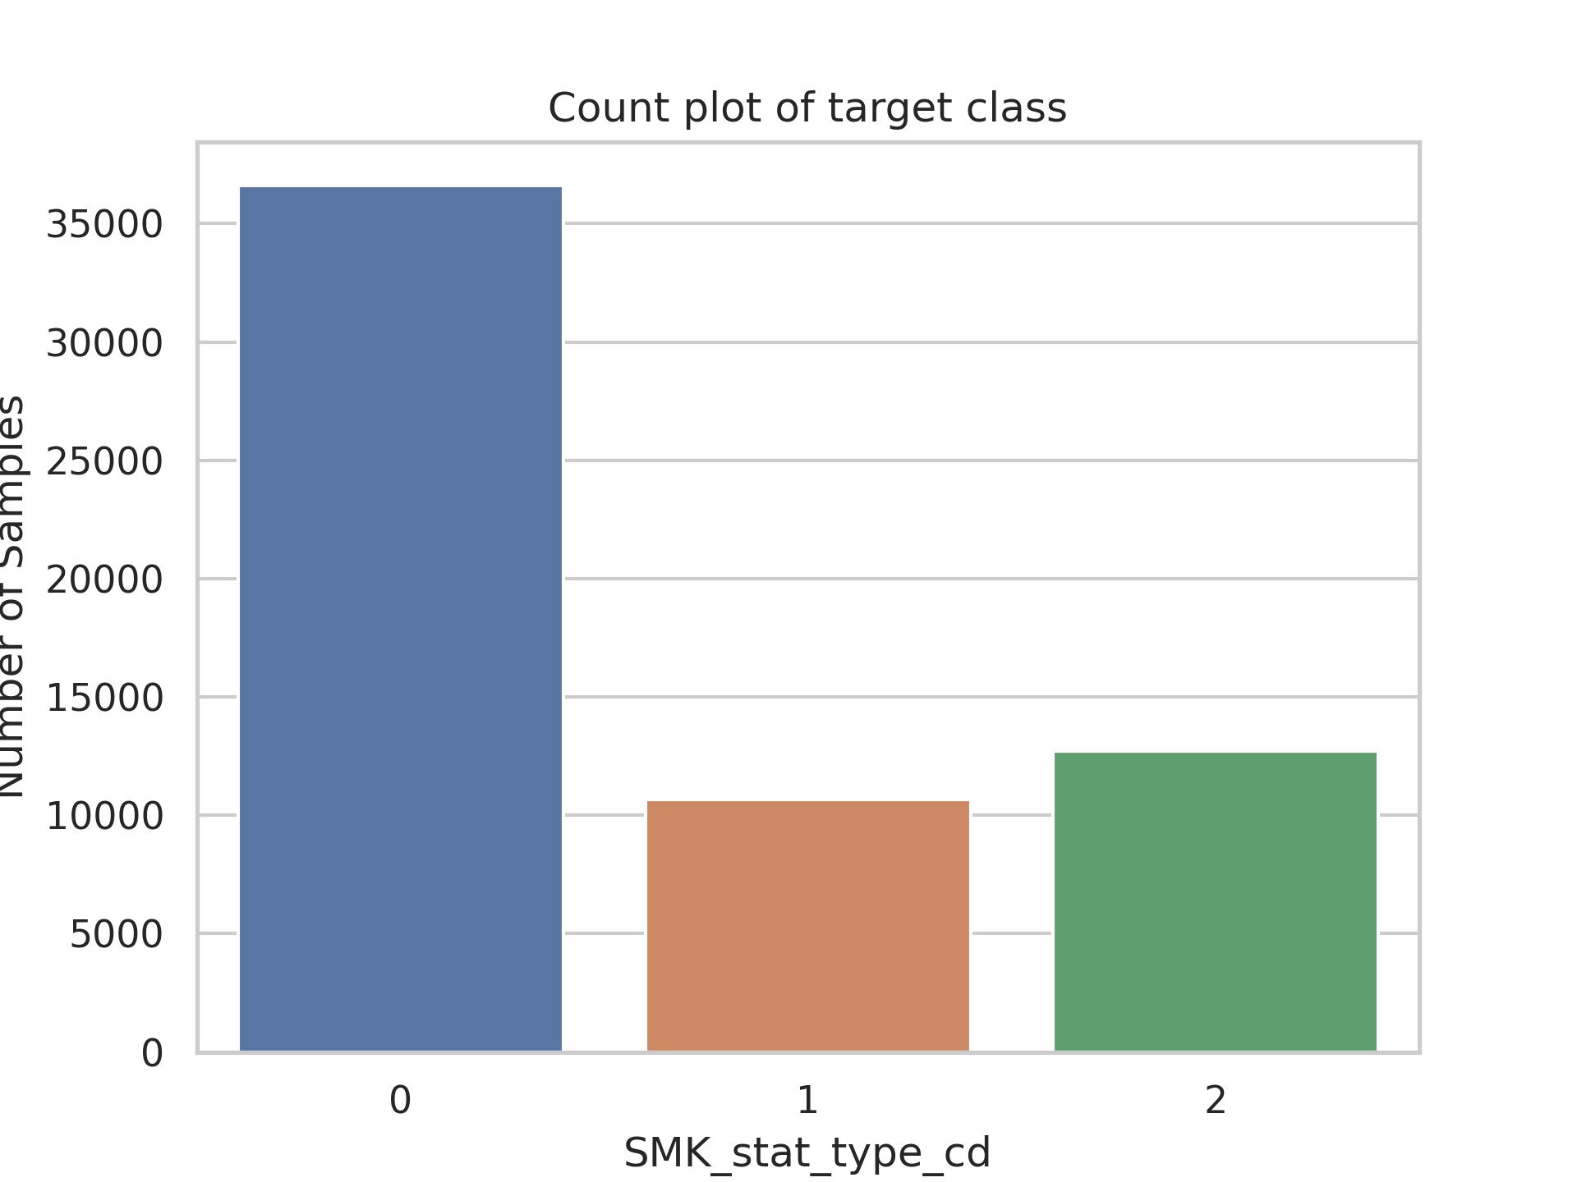
Predictis
Phase 1: Data Preprocessing & EDA
Balanced or imbalanced data?
A Medical Decision Making Daignosis System

Slide 9
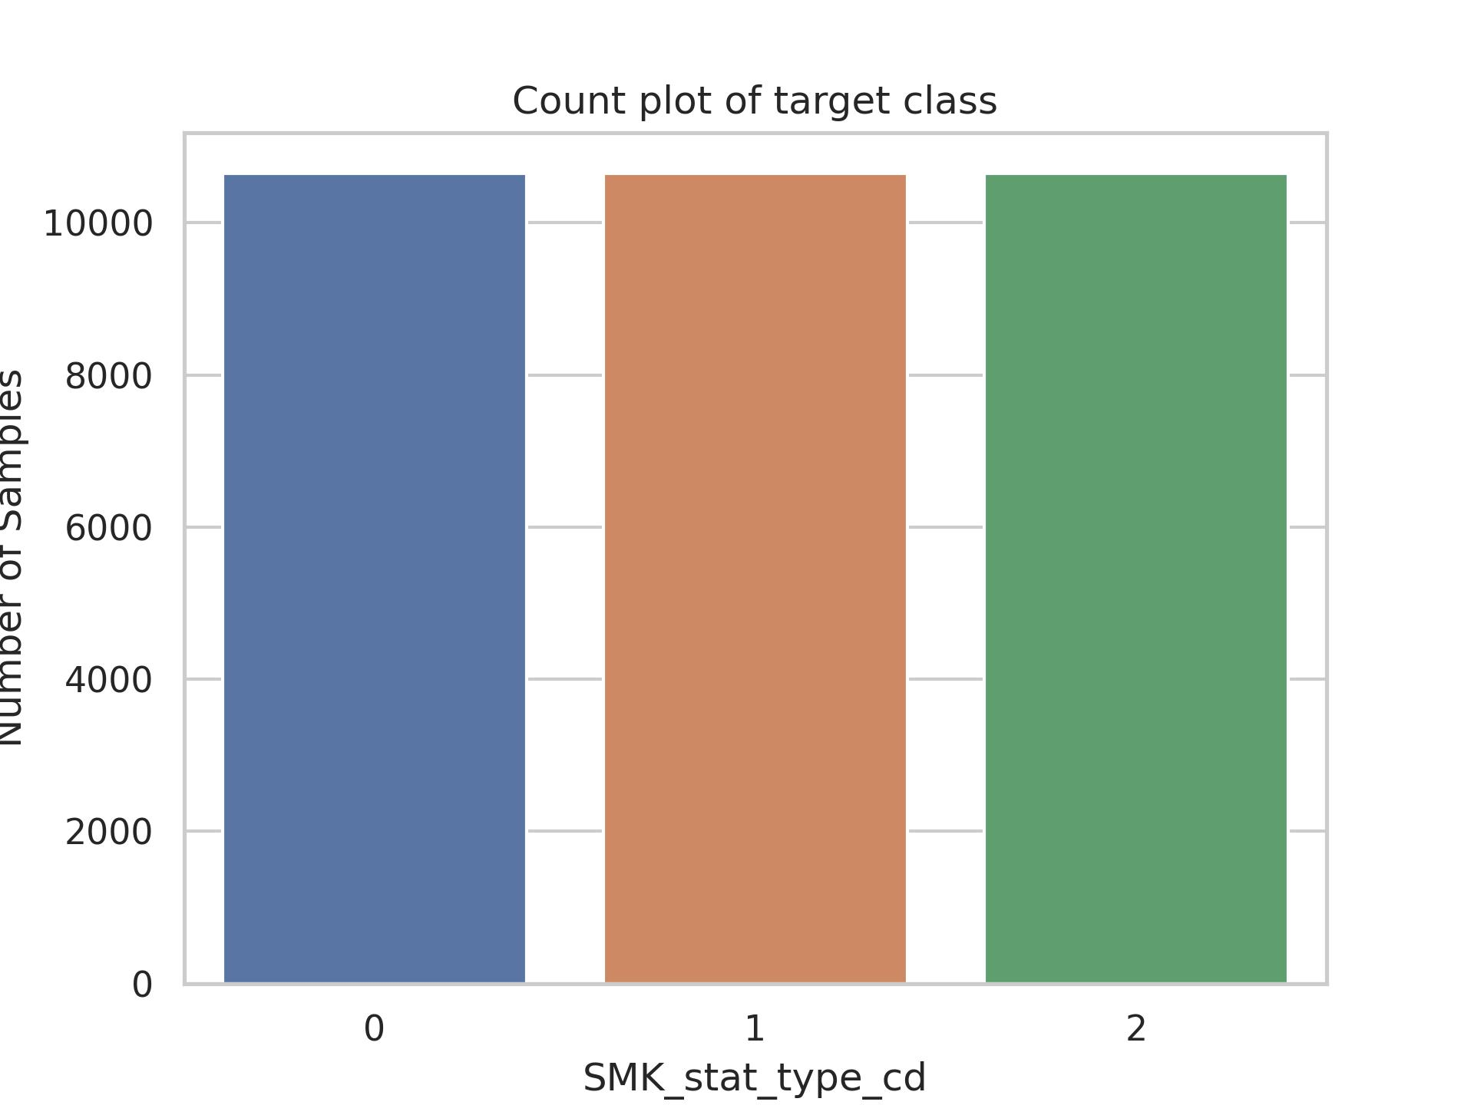
Predictis
Phase 1: Data Preprocessing
Downsampled dataset: Before balancing: (54396, 24) After balancing: (31962, 24), removed: 22,434
A Medical Decision Making Daignosis System

Slide 10
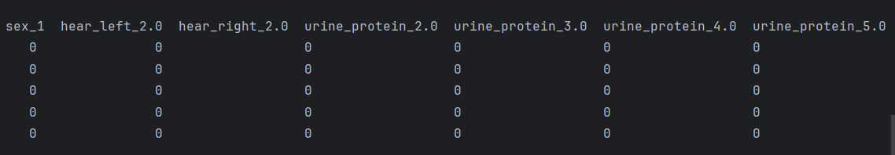
Predictis
Phase 1: Data Preprocessing
Discretization & Binarization: One Hot Encoding
To avoid the dummy variable trap, one binary column is dropped for each categorical feature during OHE.
A Medical Decision Making Daignosis System

Slide 11
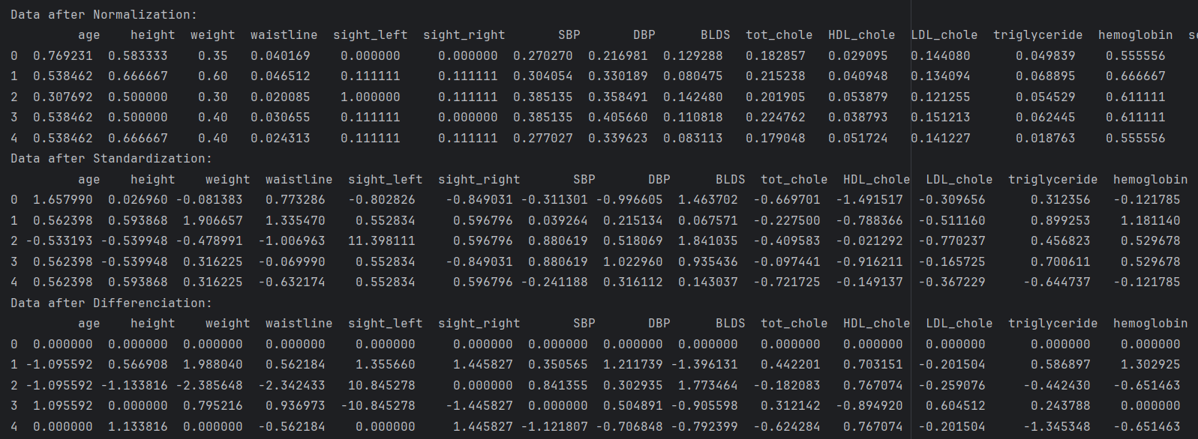
Predictis
Phase 1: Data Preprocessing
Variable Transformation: Standardization, Normalization, Differencing
A Medical Decision Making Daignosis System

Slide 12
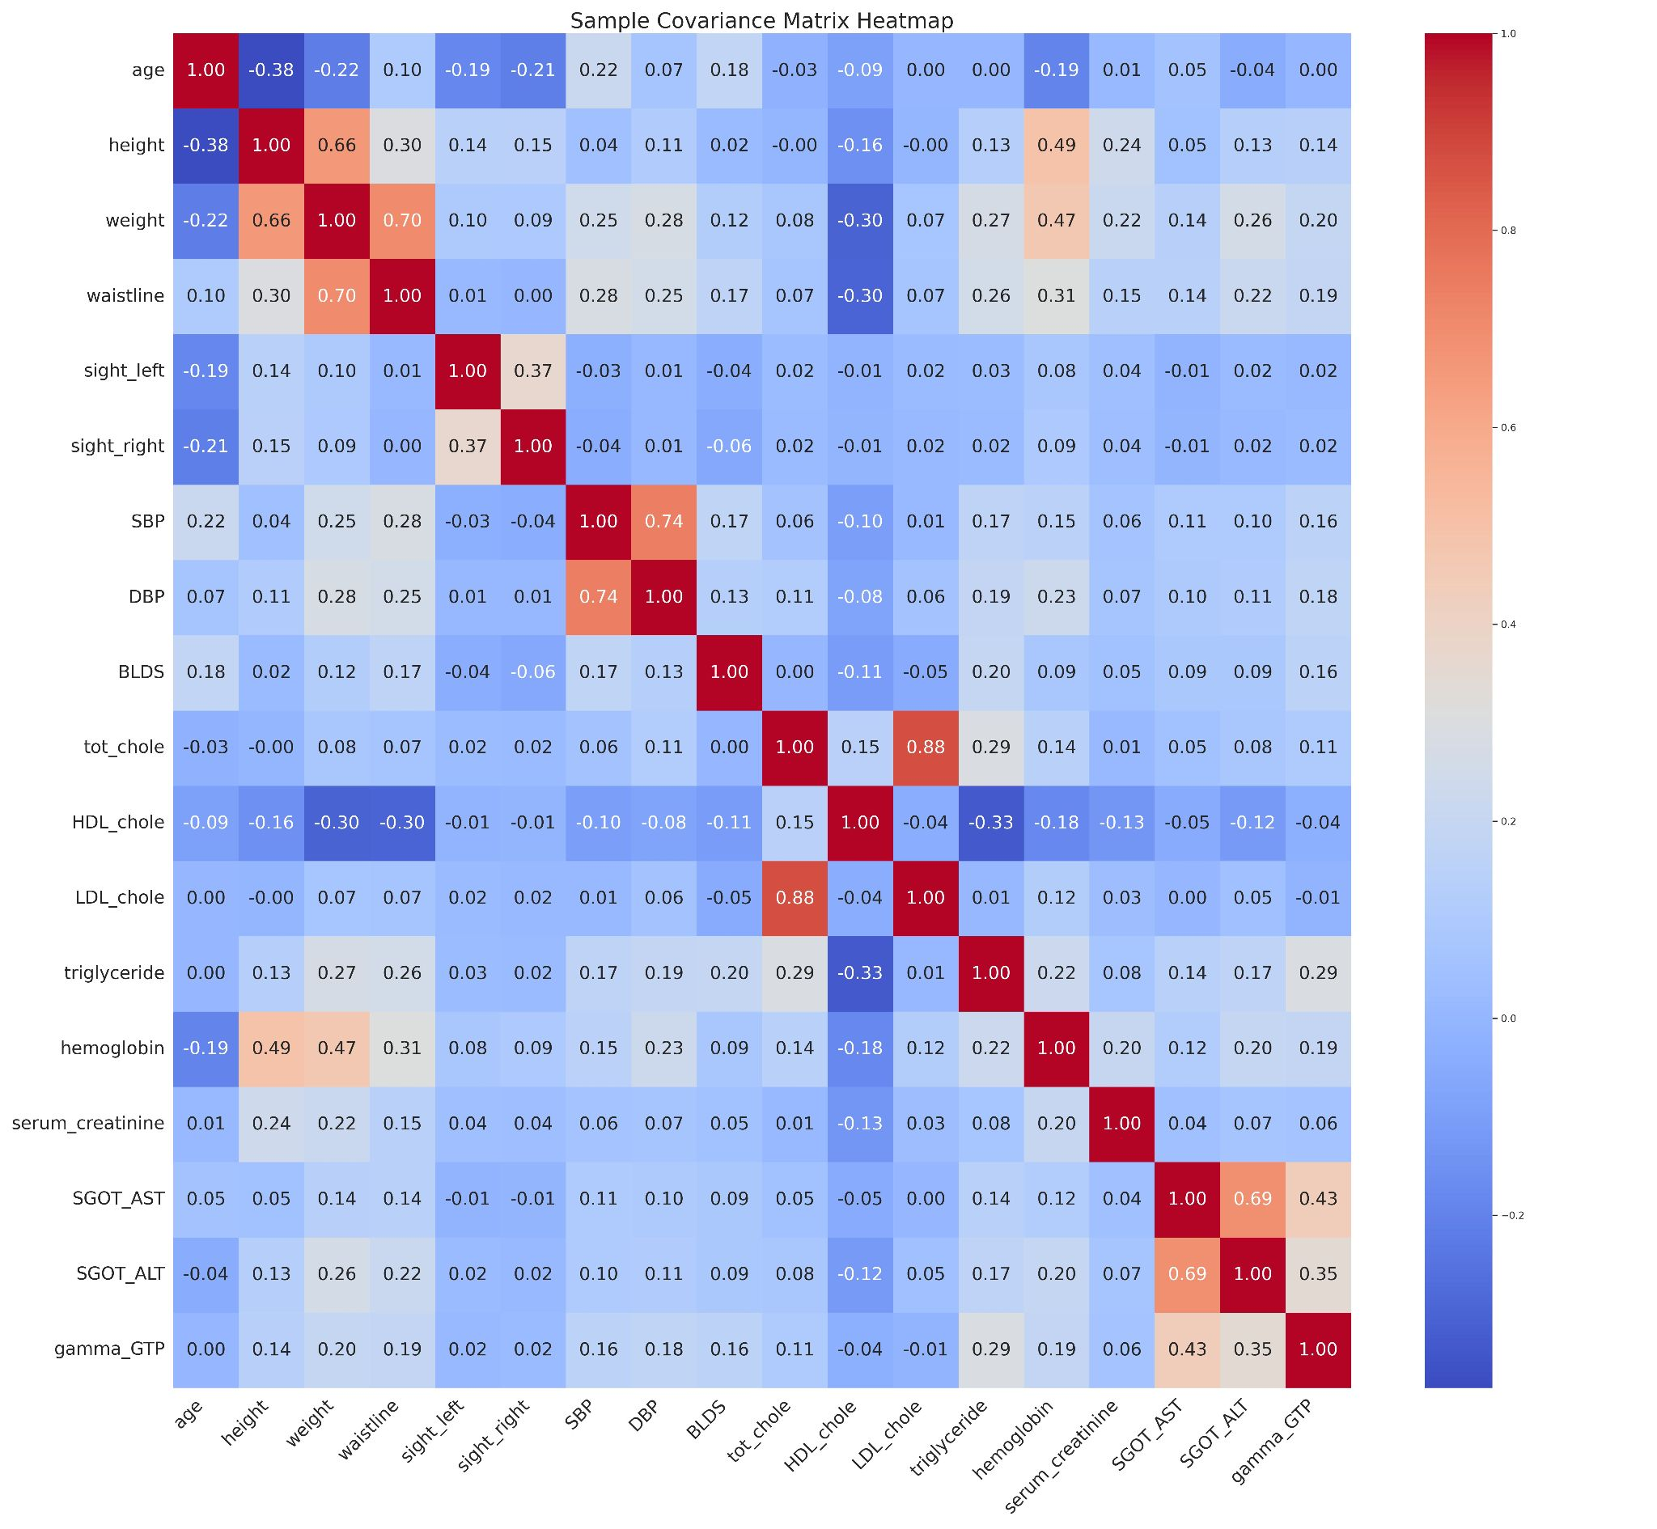
Predictis
Phase 1: Data Preprocessing
Sample Covariance Matrix display through heatmap graph
A Medical Decision Making Daignosis System

Slide 13
Predictis
Phase 1: Data Preprocessing & EDA
'weight' and 'waistline' exhibit a strong positive covariance of 0.704, suggesting that as weight increases, the waistline also tends to increase.
height' and 'age' have a negative covariance of -0.375, suggesting a tendency for shorter individuals to be older.
'sight_left' and 'sight_right' have low covariance, indicating weak correlation.
'DBP' (Diastolic Blood Pressure) and 'SBP' (Systolic Blood Pressure) with a covariance of 0.737, reflecting a positive correlation.
Features related to cholesterol levels ('tot_chole', 'HDL_chole', 'LDL_chole') show high positive covariances, suggesting multicollinearity. This could be a consideration for regression models.
A Medical Decision Making Daignosis System

Slide 14
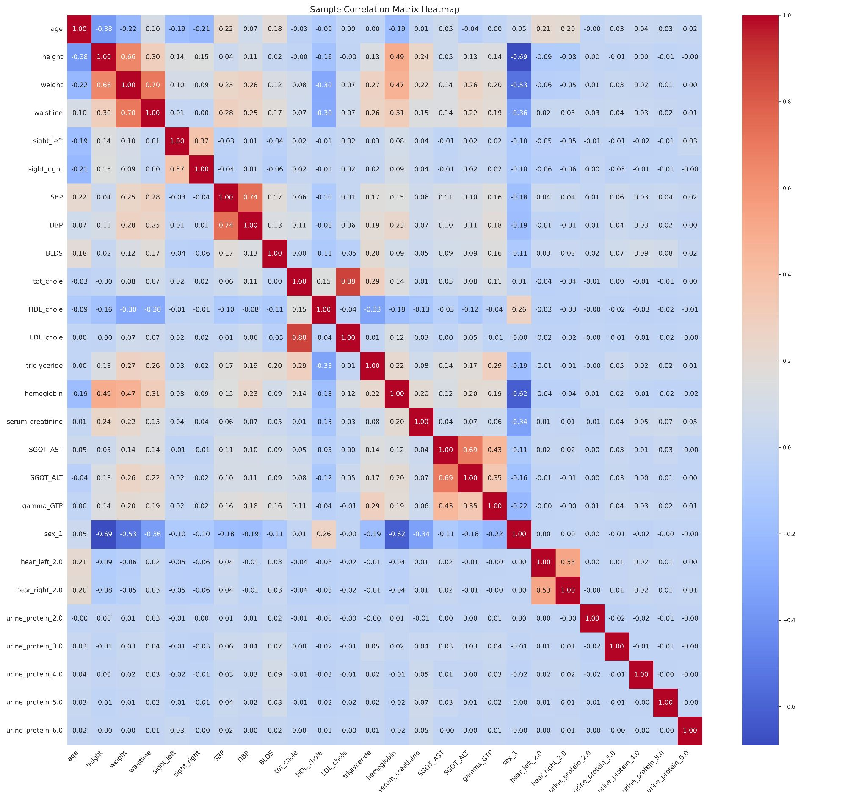
Predictis
Phase 1: Data Preprocessing
Sample Pearson Correlation coefficients Matrix display through heatmap graph
A Medical Decision Making Daignosis System

Slide 15
Predictis
Phase 1: Data Preprocessing & EDA
Age-related Insights:
Negative correlation with height (-0.38) and positive correlation with weight (0.22), waistline (0.10), and SBP (0.22).
Body Measurements:
Strong positive correlation between height and weight (0.66).
Strong positive correlations between weight and waistline (0.70)..
Blood Pressure:
Strong positive correlation between SBP and DBP (0.74).
Cholesterol Levels:
Positive correlations among cholesterol levels (tot_chole, HDL_chole, LDL_chole, triglycerides).
Negative correlation of HDL_chole with weight and waistline.
Vision:
Positive correlation between sight_left and sight_right (0.37).
Gender-related Insights:
Strong negative correlation between height and 'sex_1' (-0.69), indicating shorter females.
'sex_1' negatively correlated with weight and waistline, suggesting females have lower weights and smaller waistlines.
Liver-related Insights:
Positive correlation between SGOT_AST and SGOT_ALT, suggesting a correlation in these blood enzyme levels.
Urine Protein Levels:
Weak positive correlations between urine protein levels (urine_protein_2.0 to urine_protein_6.0), suggesting potential associations.
Other Insights:
Hemoglobin has a strong positive correlation with height (0.49) and negative correlation with 'sex_1', indicating potential gender differences.
Serum creatinine shows positive correlations with various body measurements.
A Medical Decision Making Daignosis System

Slide 16
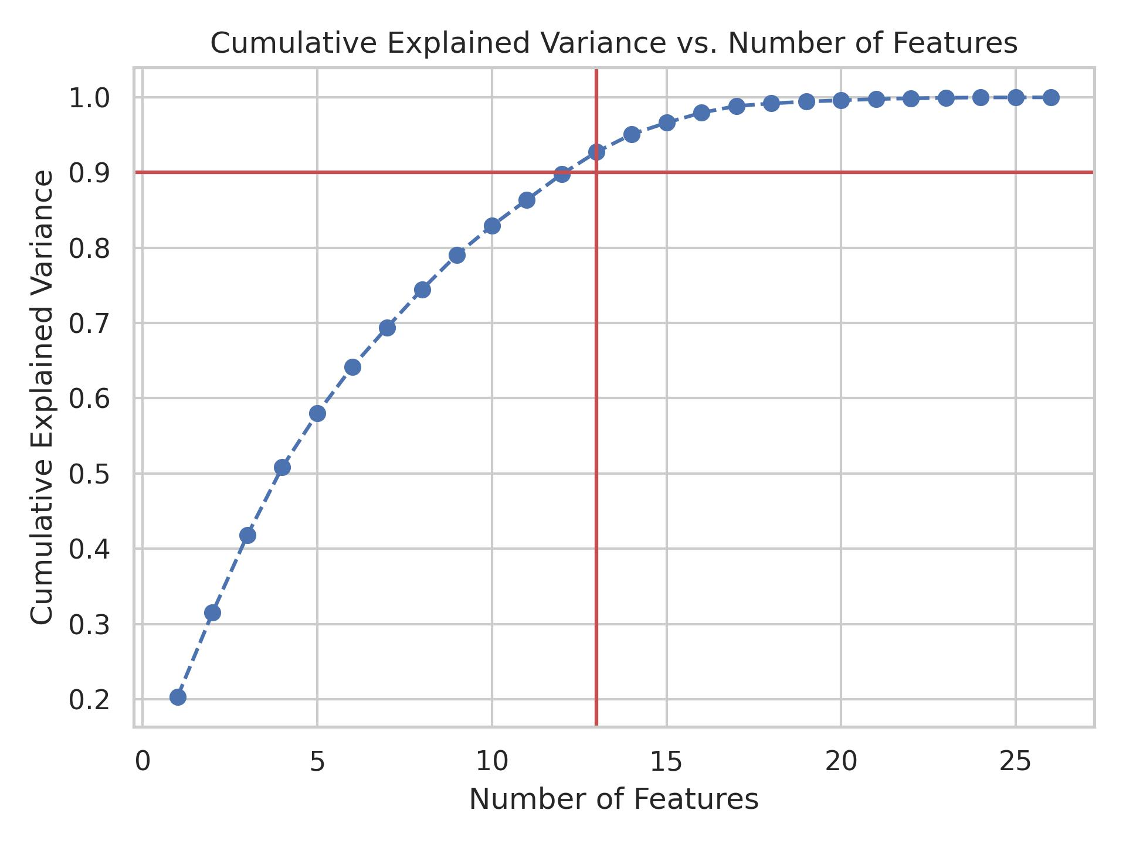
Predictis
Phase 1: Data Preprocessing & EDA
Dimensionality reduction/feature selection: Principal Component Analysis: Number of features are needed that explain more than 90% of the dependent variance: 13
A Medical Decision Making Daignosis System

Slide 17
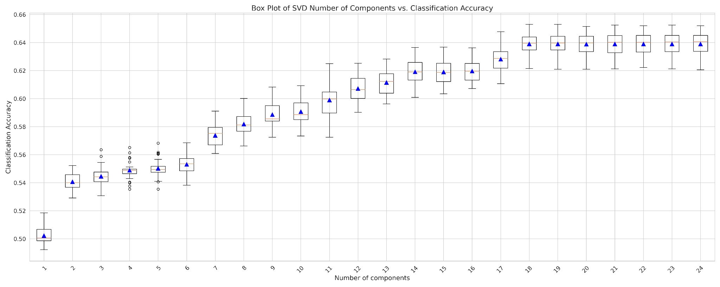
Predictis
Phase 1: Data Preprocessing & EDA
Dimensionality reduction/feature selection: Singular Value Decomposition : n_component selection
A Medical Decision Making Daignosis System

Slide 18
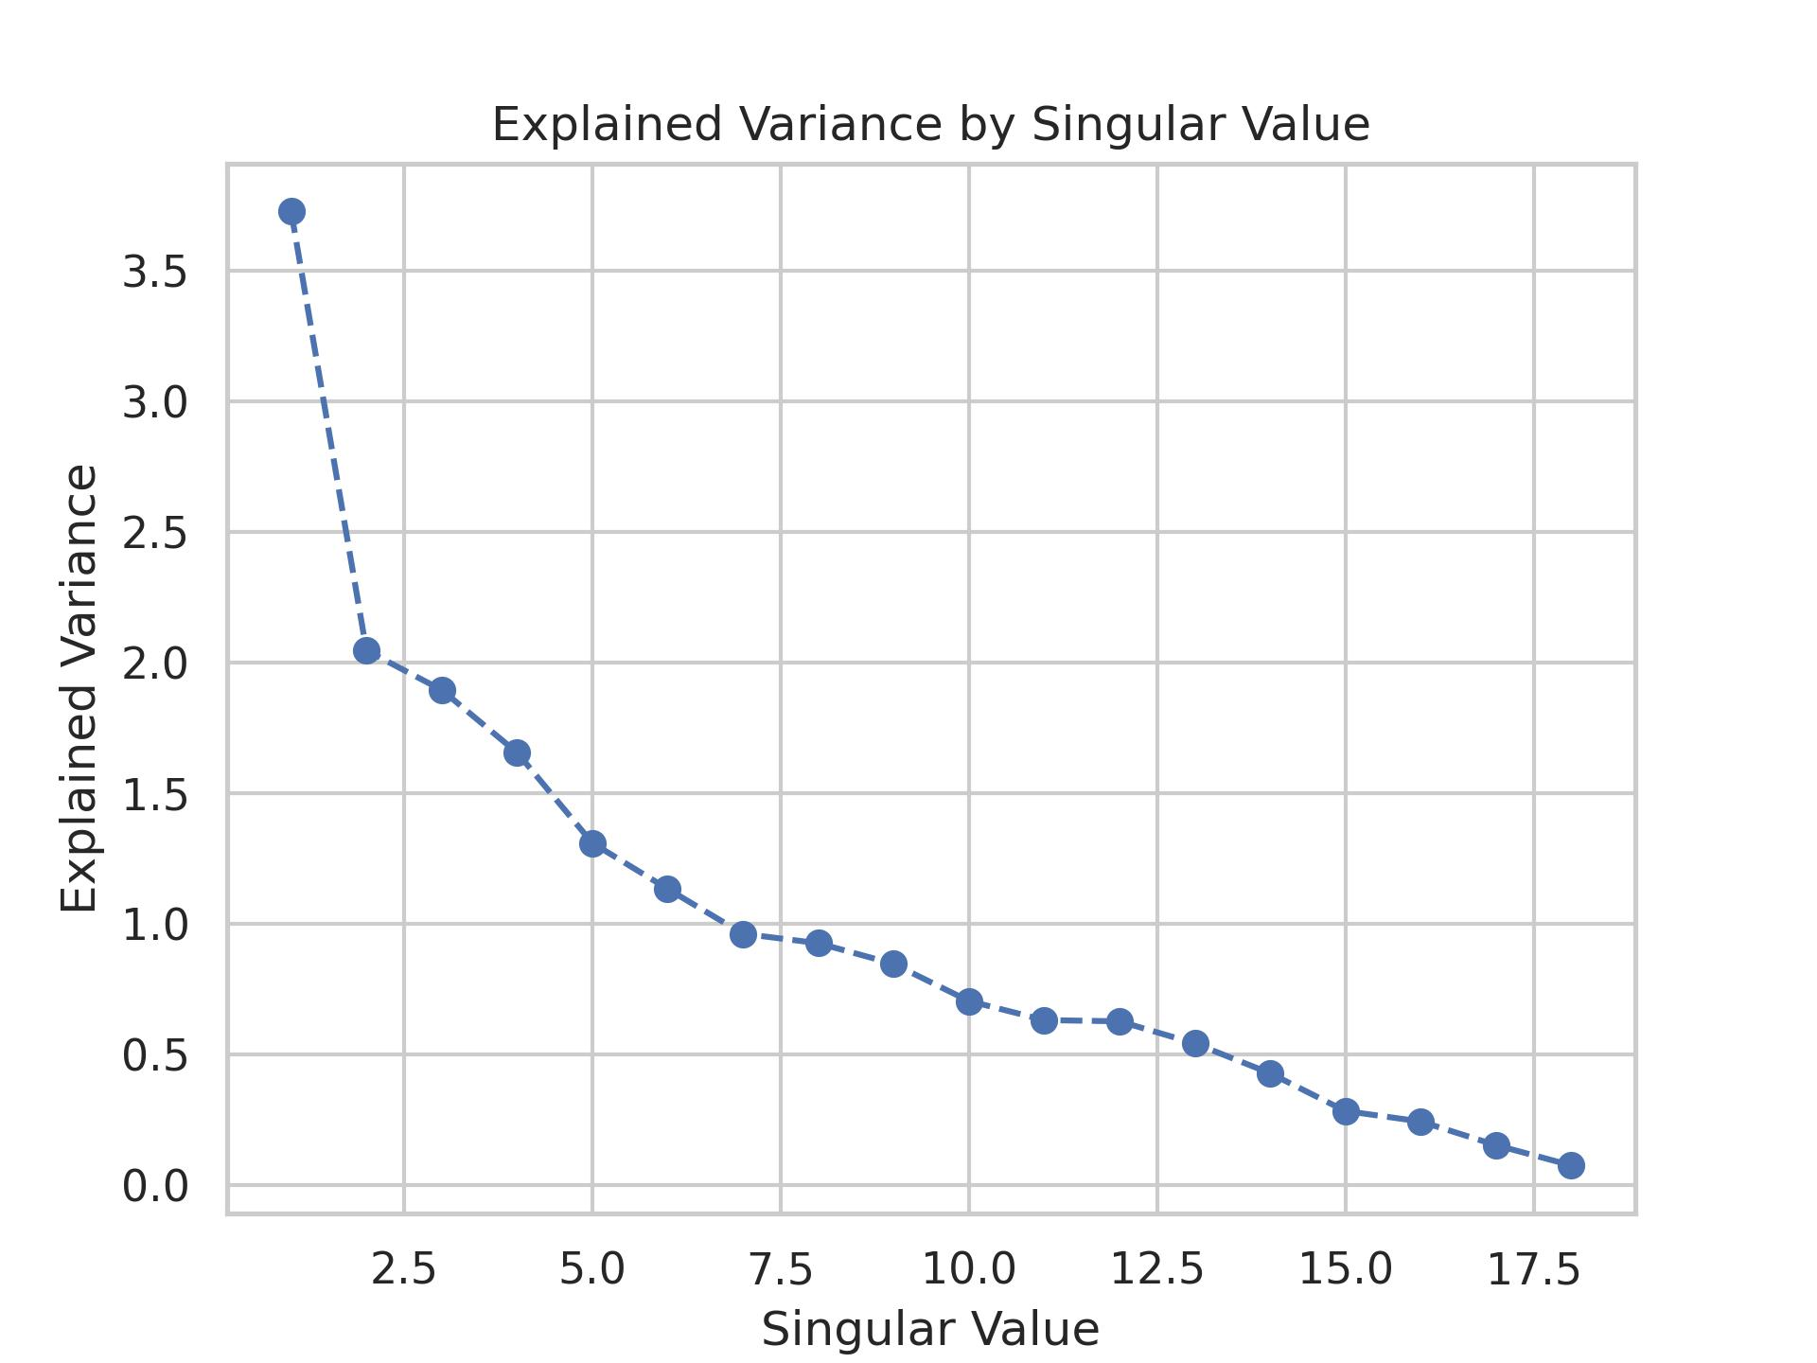
Predictis
Phase 1: Data Preprocessing & EDA
Dimensionality reduction/feature selection: Singular Value Decomposition : n_component=18
A Medical Decision Making Daignosis System

Slide 19
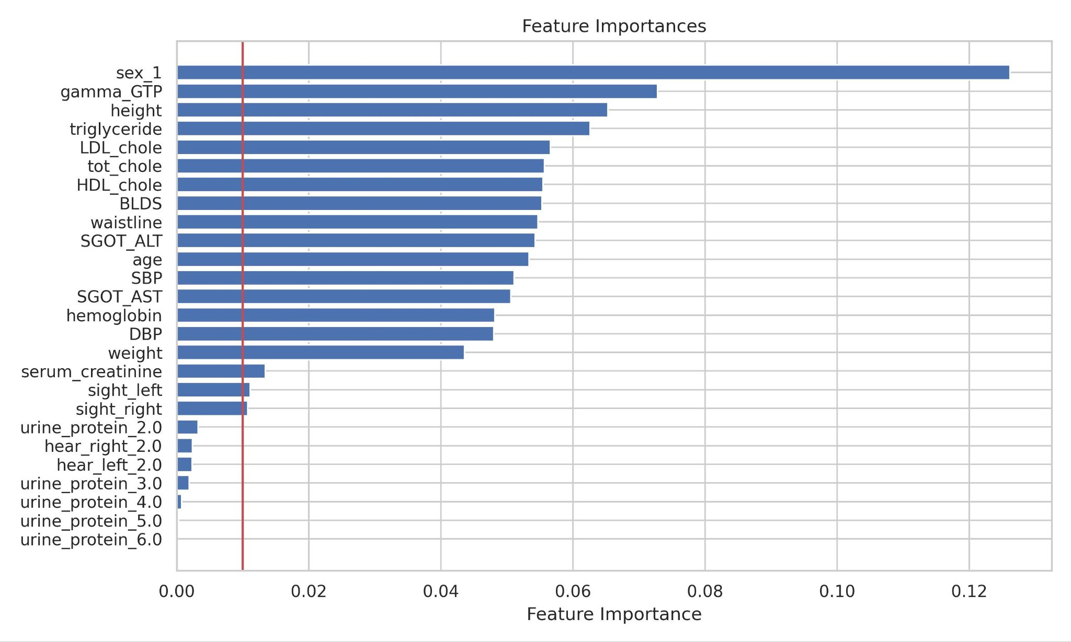
Predictis
Phase 1: Data Preprocessing & EDA
Dimensionality reduction/feature selection: Random Forest Feature Importance Analysis : threshold=0.01
A Medical Decision Making Daignosis System

Slide 20
Predictis
Phase 1: Data Preprocessing & EDA
Dimensionality reduction/feature selection: Random Forest Analysis:
threshold= 0.01
Eliminated Features:
['hear_left_2.0', 'hear_right_2.0', 'urine_protein_2.0', 'urine_protein_3.0', 'urine_protein_4.0', 'urine_protein_5.0', 'urine_protein_6.0']
Final Selected Features:
['age', 'height', 'weight', 'waistline', 'sight_left', 'sight_right', 'SBP', 'DBP', 'BLDS', 'tot_chole', 'HDL_chole', 'LDL_chole', 'triglyceride', 'hemoglobin', 'serum_creatinine', 'SGOT_AST', 'SGOT_ALT', 'gamma_GTP', 'DRK_YN', 'sex_1']
A Medical Decision Making Daignosis System

Slide 21
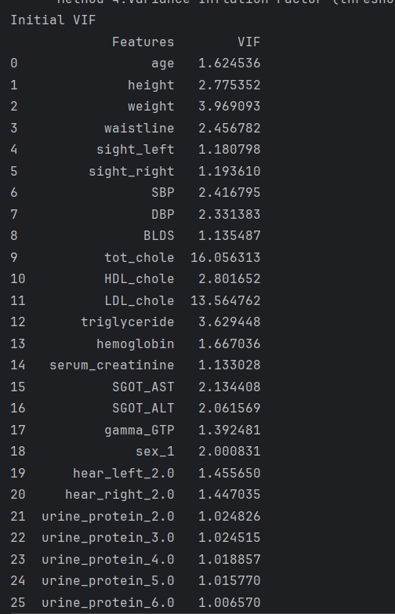
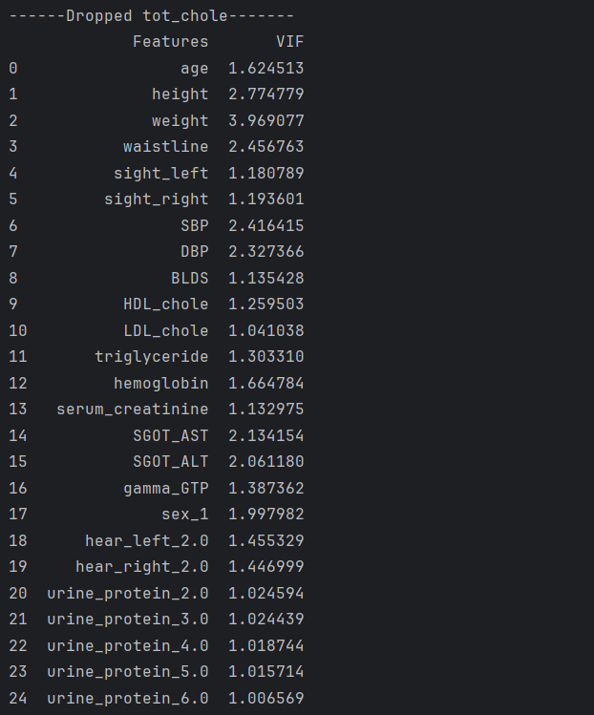
Predictis
Phase 1: Data Preprocessing & EDA
Dimensionality reduction/feature selection: Variance Inflation factor (threshold 5.0):
A Medical Decision Making Daignosis System

Slide 22
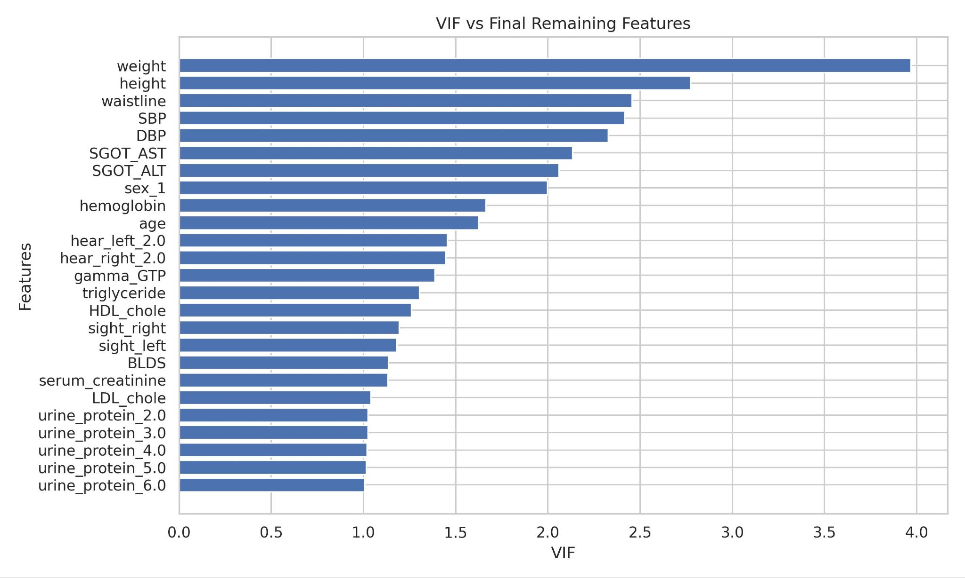
Predictis
Phase 1: Data Preprocessing & EDA
Dimensionality reduction/feature selection: Variance Inflation Factor: 24 features
A Medical Decision Making Daignosis System

Slide 23
Predictis
Phase 1: Data Preprocessing & EDA
Observations and Choosing Feature Selection Technique:
Dimensionality reduction techniques like PCA and SVD were applied to know the number of features needed for explaining certain variances. Since theses methods cannot tell which features to remove they have not been chosen for final dimensionality reduction.
The Random forest feature importance is highly intuitive and tells specifically which features are important for supervised machine learning problems. So this method has been picked for the final dimensionality reduction of the dataset.
The dimensionality reduction technique VIF can address all the multicollinearity issues in the dataset.
A Medical Decision Making Daignosis System

Slide 24
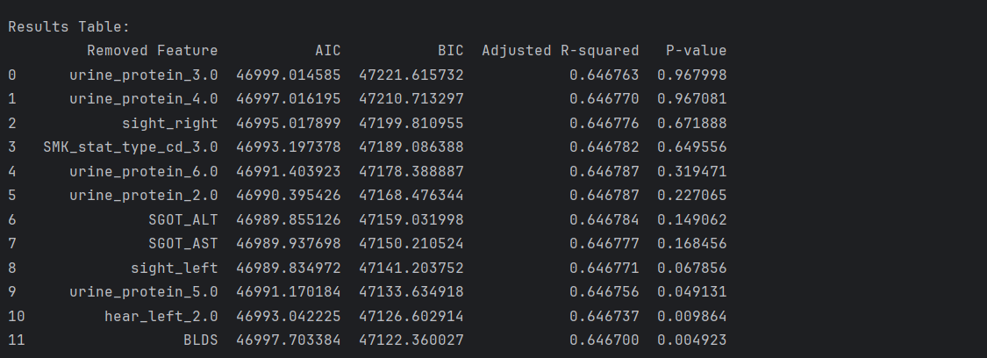
Predictis
Phase 2: Regression Analysis
Chosen Target: Total_cholesterol
Stepwise Regression and R-square analysis
A Medical Decision Making Daignosis System

Slide 25
Predictis
Phase 2: Regression Analysis
Chosen Target: Total_cholesterol
Stepwise Regression and R-square analysis Final Selected Features: 13
['const', 'age', 'height', 'weight', 'SBP', 'HDL_chole', 'LDL_chole', 'triglyceride', 'hemoglobin', 'serum_creatinine', 'gamma_GTP', 'DRK_YN_1', 'SMK_stat_type_cd_2.0']
Eliminated Features: 12
['urine_protein_3.0', 'urine_protein_4.0', 'sight_right', 'SMK_stat_type_cd_3.0', 'urine_protein_6.0', 'urine_protein_2.0', 'SGOT_ALT', 'SGOT_AST', 'sight_left', 'urine_protein_5.0', 'hear_left_2.0', 'BLDS']
A Medical Decision Making Daignosis System

Slide 26
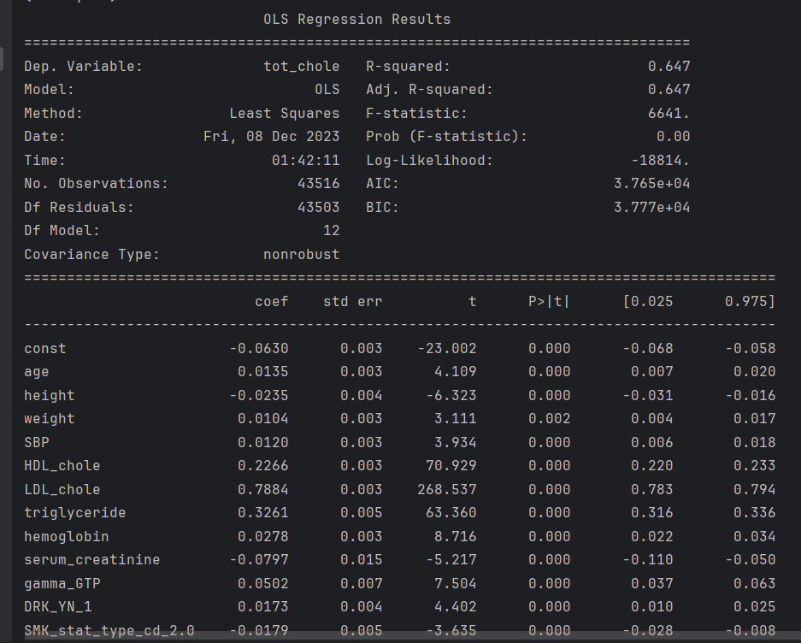
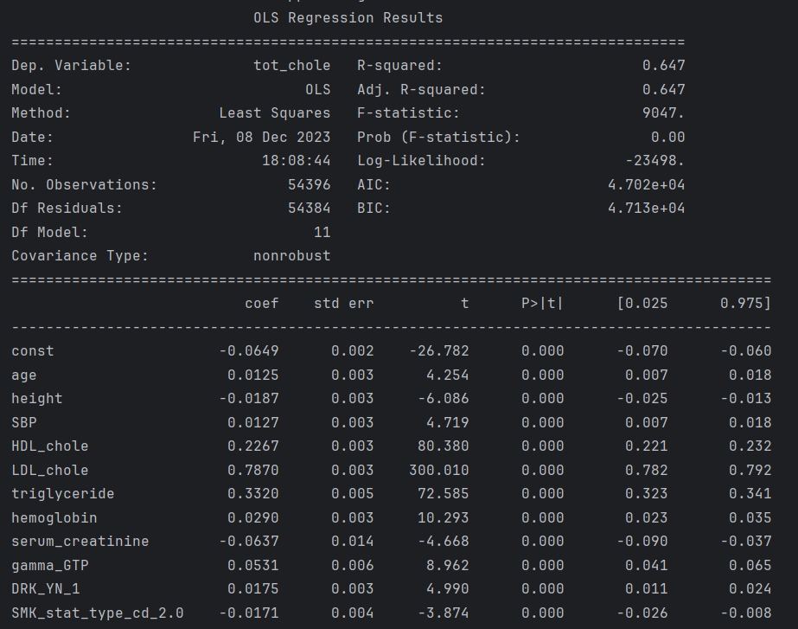
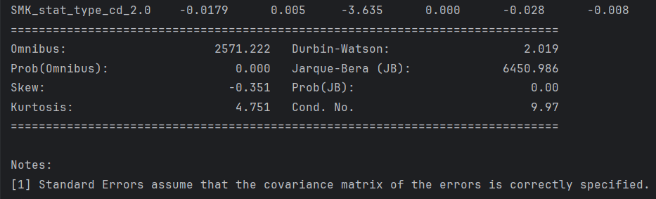
Predictis
Phase 2: Regression Analysis
Final Regression Model:
A Medical Decision Making Daignosis System

Slide 27
Predictis
Phase 2: Regression Analysis
Final Regression Model:
A Medical Decision Making Daignosis System

Slide 28
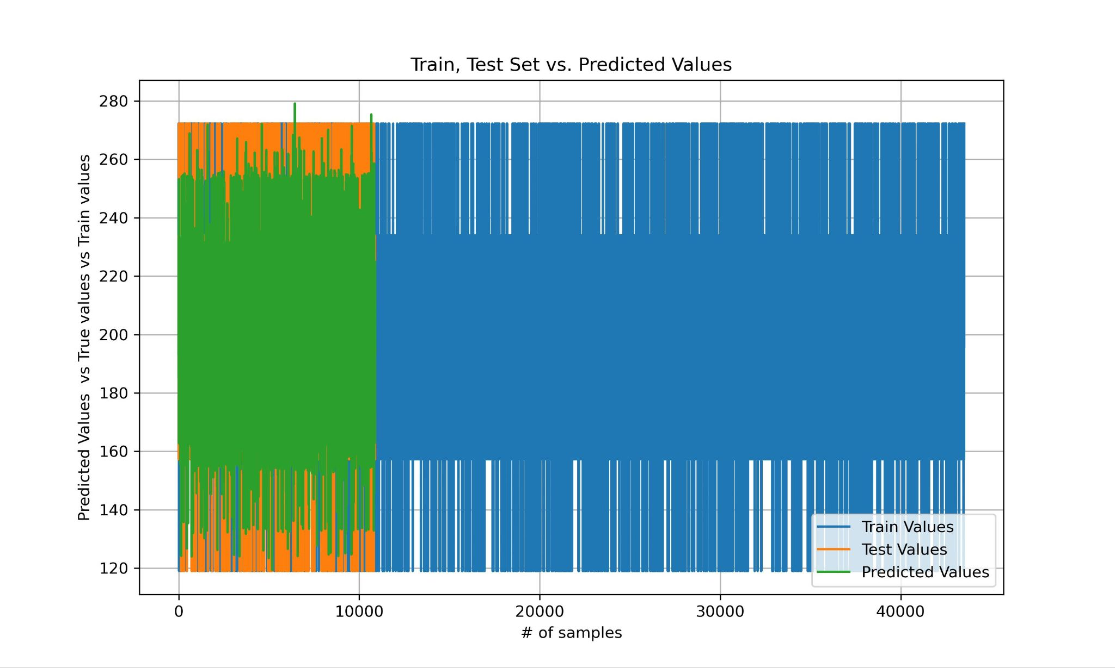
Predictis
Phase 2: Regression Analysis
Final Regression Model:
A Medical Decision Making Daignosis System

Slide 29
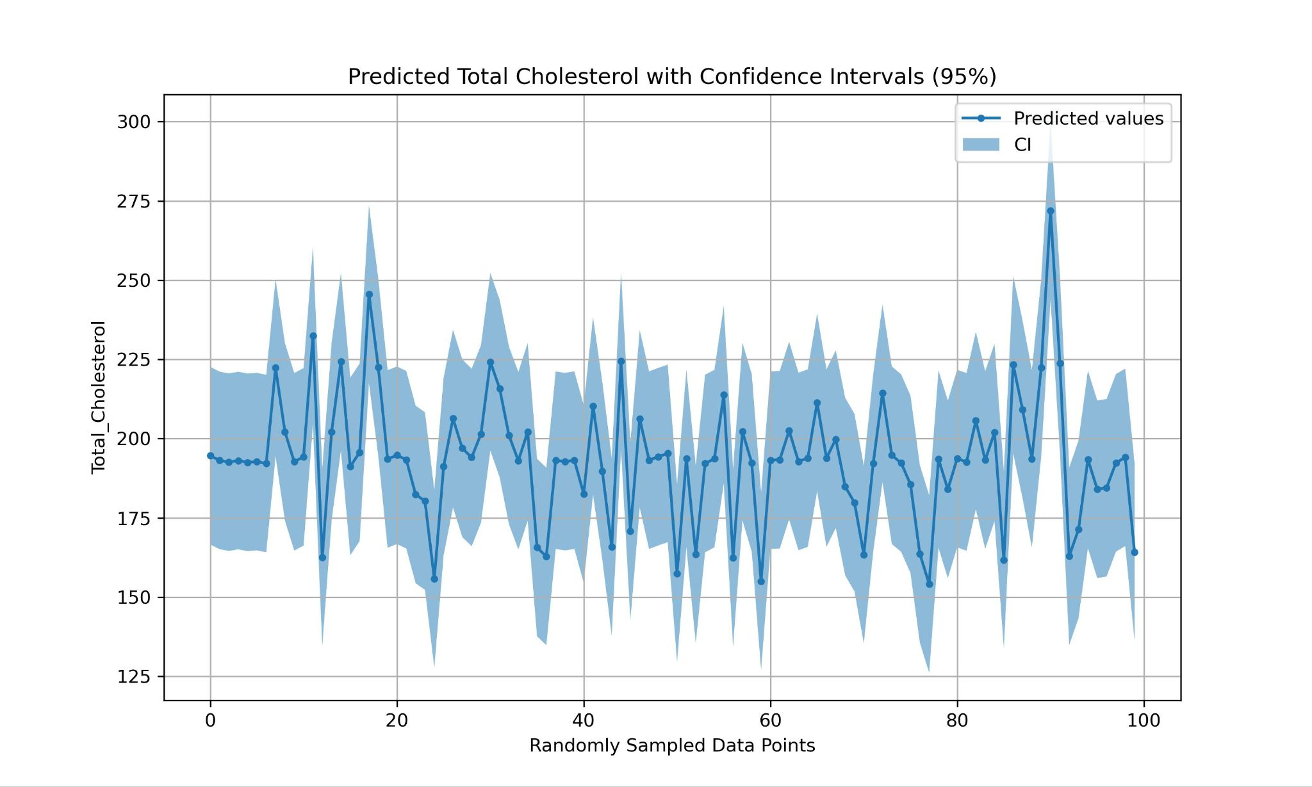
Predictis
Phase 2: Regression Analysis
Prediction Interval Analysis:
A Medical Decision Making Daignosis System

Slide 30
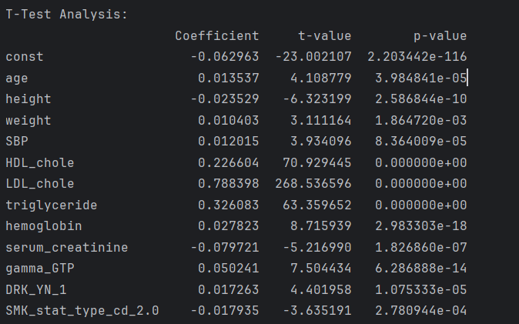
Predictis
Phase 2: Regression Analysis
T- test Analysis: Null Hypothesis Rejected. Coefficients are Statistically Significant.
A Medical Decision Making Daignosis System

Slide 31
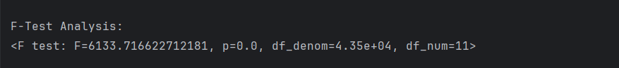
Predictis
Phase 2: Regression Analysis
F- test Analysis:
Interpretation:
F-statistic: The value of the F-statistic is 6133.72. This is a large value, indicating that the variance explained by the model is much greater than the unexplained variance.
p-value: The p-value is very close to zero (scientific notation is used). This suggests strong evidence against the null hypothesis that all coefficients are zero, indicating that at least one of the independent variables has a significant effect on the dependent variable.
A Medical Decision Making Daignosis System

Slide 32
Predictis
Phase 3: Classification
The Machine Learning Models Explored in this phase are:
Decision Trees
Logistic Regression
K-Nearest Neighbors
Naive Bayes
Support Vector Machine
Random Forest
Multilayer Perceptron Network
Bagging: Random Forest Classifier
Boosting : Extra Gradient Boosting Classifier
Stacking: Base Estimators: MLP, SVC and XGB; Final Estimator: Random Forest
A Medical Decision Making Daignosis System

Slide 33
Predictis
Phase 3: Classification
For each model, grid search has been performed to get the best hyperparameters:
Algorithm | Best Parameters
Decision Trees Pre Pruning | Best Parameters of DT after Pre Pruning: {'criterion': 'gini', 'max_depth': 7, 'max_features': None, 'min_samples_leaf': 4, 'min_samples_split': 2, 'splitter': 'best'}
Decision Trees Post Pruning | Optimal Alpha: 0.00017839864883602806
Logistic Regression | Best Parameters for Logistic Regression: {'C': 0.01, 'penalty': 'l2', 'solver': 'liblinear'}
K Nearest Neighbours | Best k value: 24
Support Vector Machine | Best Params of SVC: {'C': 1, 'kernel': 'linear'}
Naïve Bayes | Best Hyperparameters for Naive bayes: {'var_smoothing': 1e-09}
Random Forest | Best Params of RF: {'max_depth': 10, 'min_samples_leaf': 1, 'min_samples_split': 10, 'n_estimators': 200}
Extra Gradient Boosting | Best Params of XGB: {'learning_rate': 0.1, 'max_depth': 3, 'n_estimators': 100}
Multilayer Perceptron Classifier | Best Parameters for MLPC: {'activation': 'logistic', 'alpha': 0.001, 'hidden_layer_sizes': (50, 50), 'max_iter': 300}
A Medical Decision Making Daignosis System

Slide 34
Predictis
Phase 3: Classification
Each models, performance evaluation has been done after stratified k-fold cross validation. Following metrics has been used for performance evaluation:
Confusion matrix
Precision
Sensitivity or Recall
Specificity
F-score
ROC and AUC curve
A Medical Decision Making Daignosis System

Slide 35
Predictis
Phase 3: Classification
Model | Precision | Recall | Specificity | F-score | Roc Auc
Logistic Regression | 0.6264 | 0.6098 | {0: 0.93, 1: 0.70, 2: 0.78} | 0.6149 | {0: 0.85, 1: 0.72, 2: 0.72},
K-Nearest Neighbours | 0.6083 | 0.5909 | {0: 0.92, 1: 0.70, 2: 0.75} | 0.5965 | {0: 0.83, 1: 0.70, 2: 0.70}
Naive Bayes | 0.5264 | 0.5294 | {0: 0.73, 1: 0.62, 2: 0.93} | 0.4843 | {0: 0.82, 1: 0.70, 2: 0.67}
Random Forest | 0.6392 | 0.6247 | {0: 0.93, 1: 0.74, 2: 0.76} | 0.6300 | {0: 0.86, 1: 0.74, 2: 0.74}
DT Pre Pruned | 0.6208 | 0.6036 | {0: 0.93, 1: 0.74, 2: 0.72} | 0.6099 | {0: 0.85, 1: 0.72, 2: 0.72}
A Medical Decision Making Daignosis System

Slide 36
Predictis
Phase 3: Classification
Model | Precision | Recall | Specificity | F-score | Roc Auc
DT Post Pruned | 0.6291 | 0.6128 | {0: 0.93, 1: 0.73, 2: 0.75} | 0.6187 | {0: 0.85, 1: 0.72, 2: 0.72}
Bagging | 0.6603 | 0.6463 | {0: 0.93, 1: 0.79, 2: 0.74} | 0.6508 | {0: 0.87, 1: 0.78, 2: 0.77}
Stacking | 0.6472 | 0.6350 | {0: 0.92, 1: 0.76, 2: 0.76} | 0.6395 | {0: 0.86, 1: 0.76, 2: 0.76}
XGBoost | 0.6415 | 0.6272 | {0: 0.93, 1: 0.74, 2: 0.76} | 0.6323 | {0: 0.86, 1: 0.75, 2: 0.74}
SVC | 0.6280 | 0.6108 | {0: 0.93, 1: 0.68, 2: 0.80} | 0.6144 | {0: 0.82, 1: 0.72, 2: 0.72}
A Medical Decision Making Daignosis System
MLP | 0.6384 | 0.6222 | {0: 0.93, 1: 0.70, 2: 0.79} | 0.6264 | {0: 0.86, 1: 0.74, 2: 0.74}

Slide 37
Predictis
Phase 3: Classification
Result Analysis
Precision:
Highest Precision: Bagging achieves the highest precision of 0.6603, indicating its ability to correctly classify positive instances.
Recall:
Highest Recall: Bagging also demonstrates the highest recall of 0.6463, showcasing its effectiveness in capturing positive instances.
Specificity:
Highest Specificity: Random Forest attains the highest specificity values for all classes, indicating its proficiency in correctly identifying negative instances.
F-score:
Highest F-score: Bagging leads with the highest F-score of 0.6508, considering both precision and recall.
Roc Auc:
Highest Roc Auc: Bagging and Stacking both achieve the highest Roc Auc values across classes, indicating their strong overall performance.
A Medical Decision Making Daignosis System

Slide 38
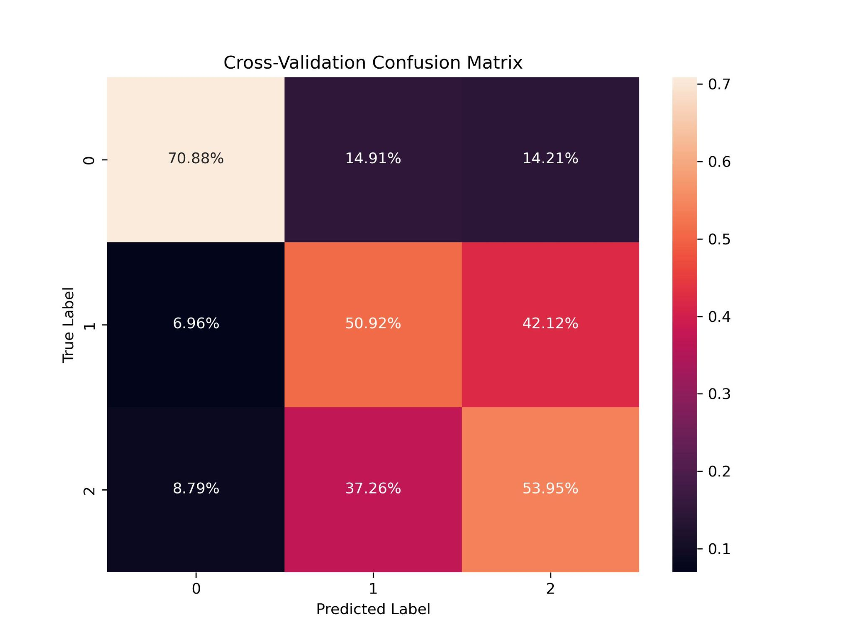
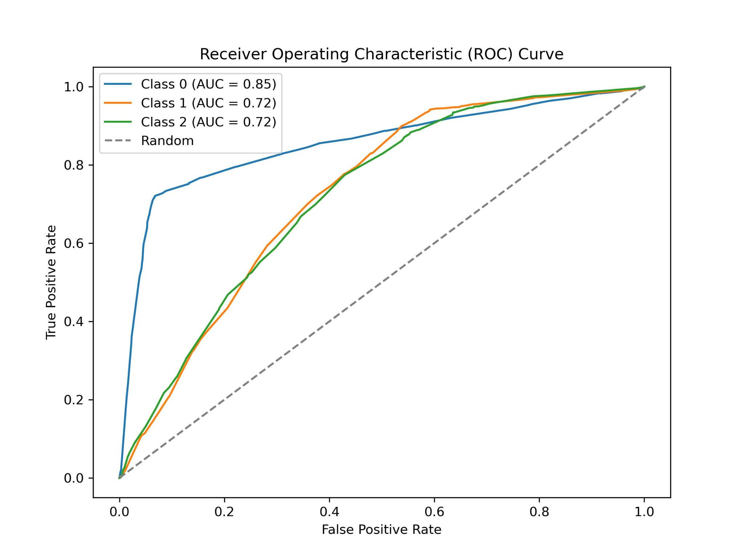
Predictis
Phase 3: Classification
Confusion Matrices and ROC-AUC
Confusion Matrix of DT Pre-Pruned Model | ROC of DT Pre-Pruned Model
A Medical Decision Making Daignosis System

Slide 39
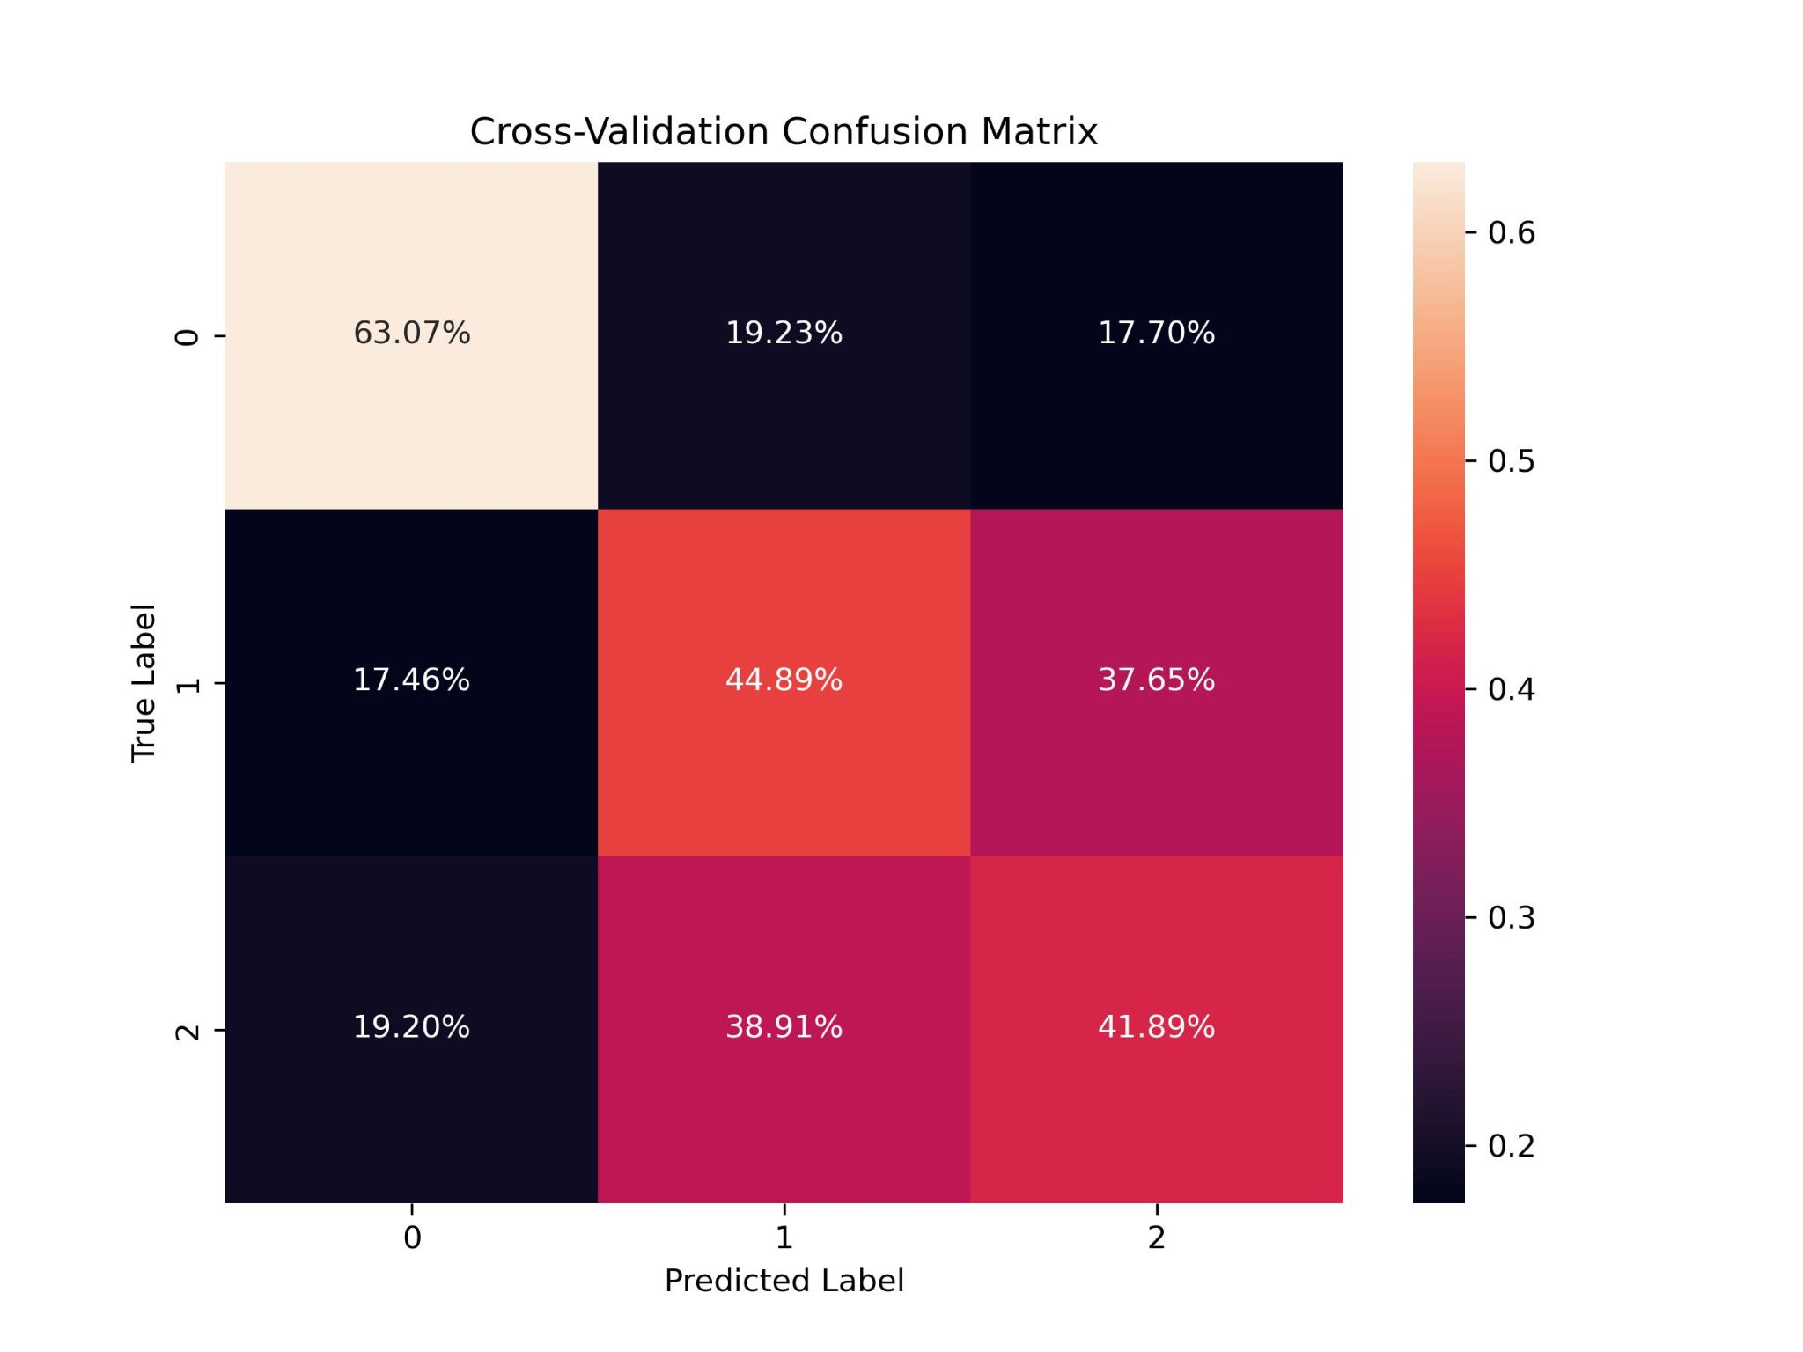
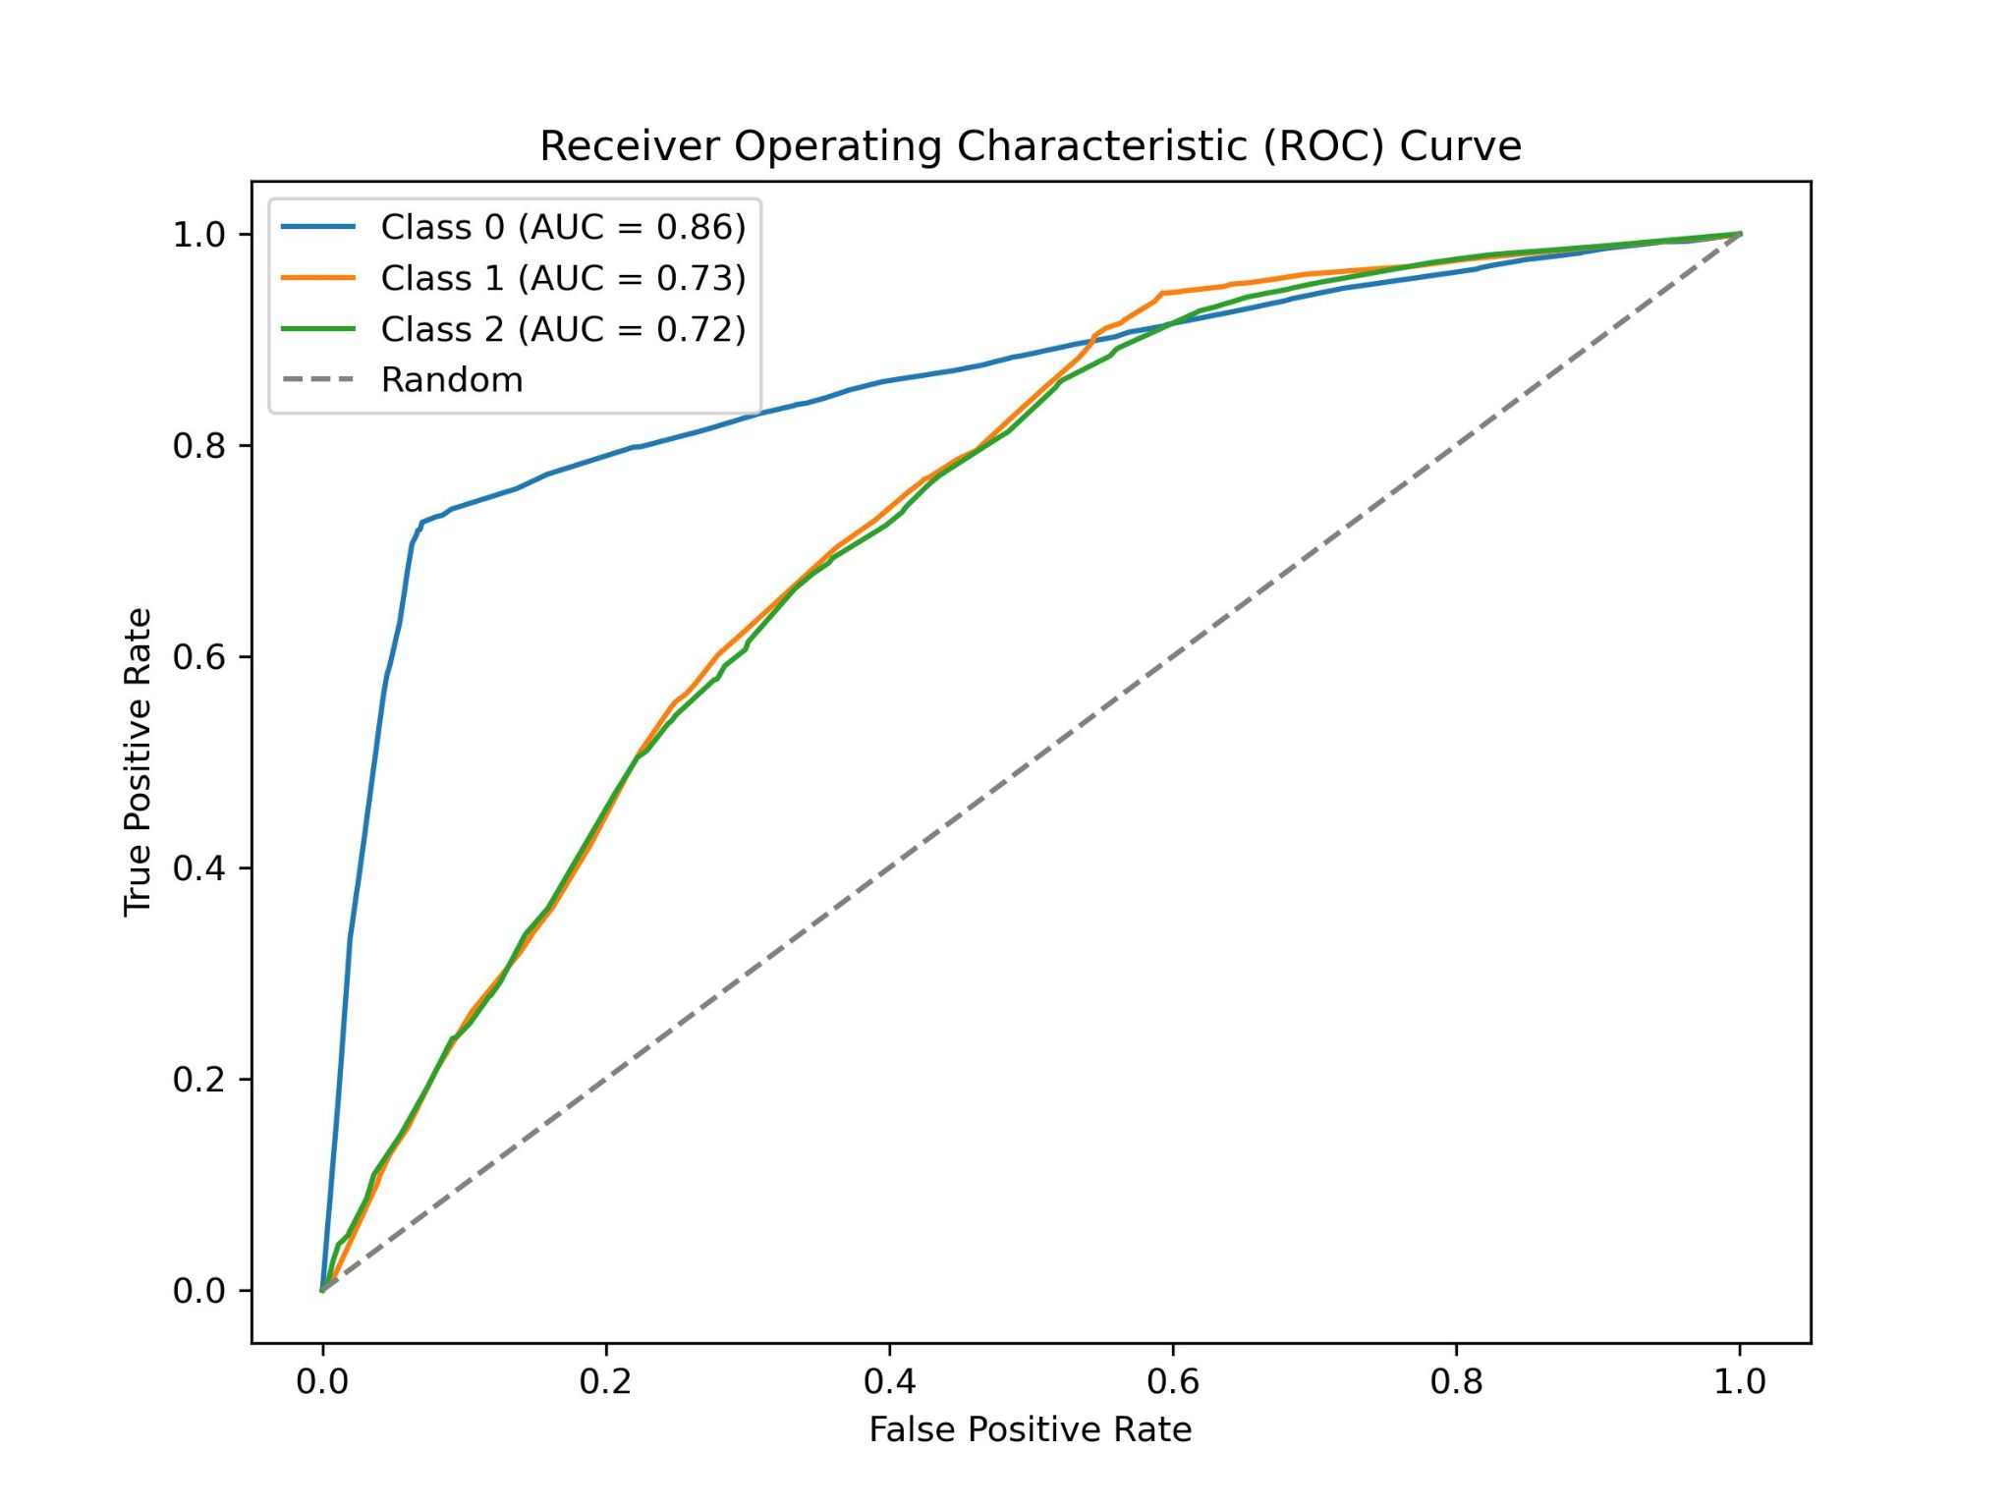
Predictis
Phase 3: Classification
Confusion Matrices and ROC-AUC
Confusion Matrix of DT Post-Pruned Model | ROC of DT Post-Pruned Model
A Medical Decision Making Daignosis System

Slide 40
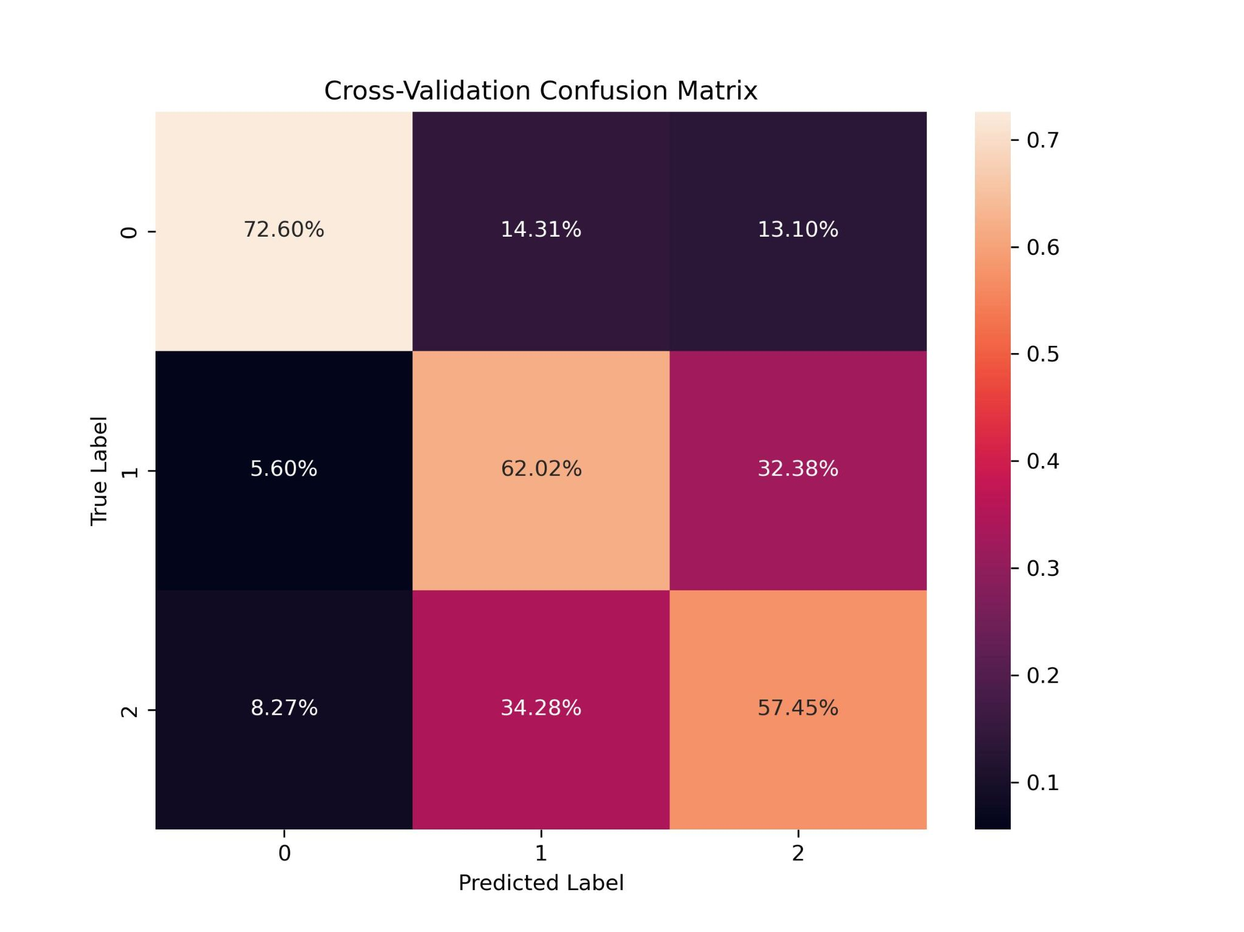
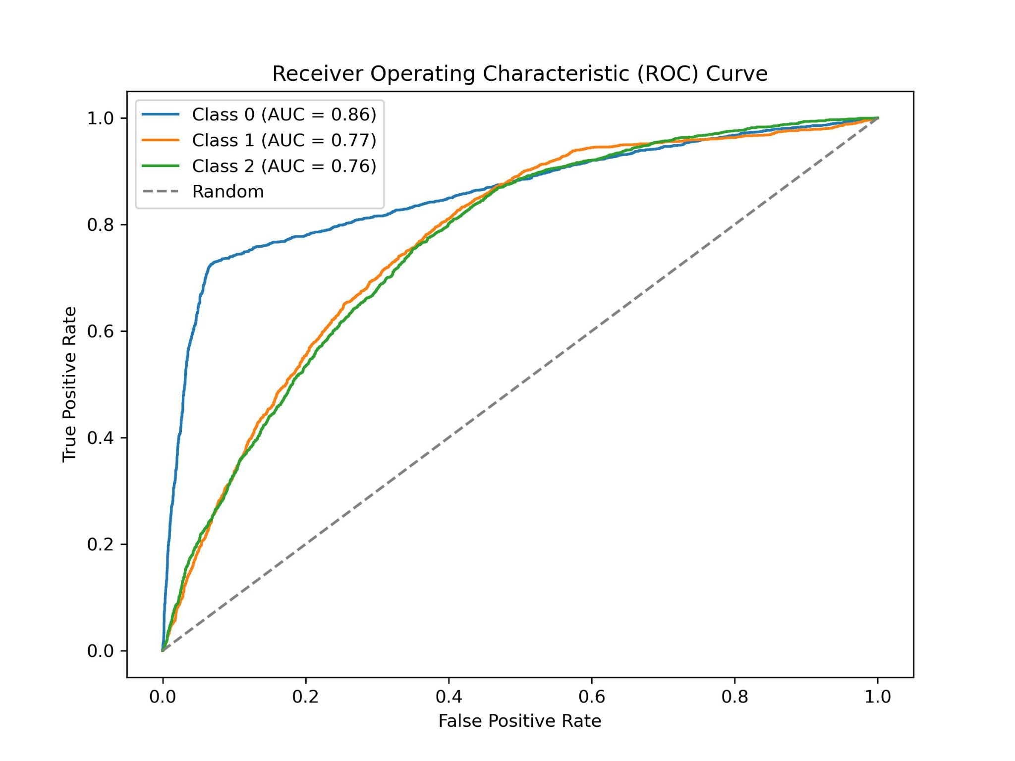
Predictis
Phase 3: Classification
Confusion Matrices and ROC-AUC
Confusion Matrix of Logistic Regression Model | ROC of Logistic Regression Model
A Medical Decision Making Daignosis System

Slide 41
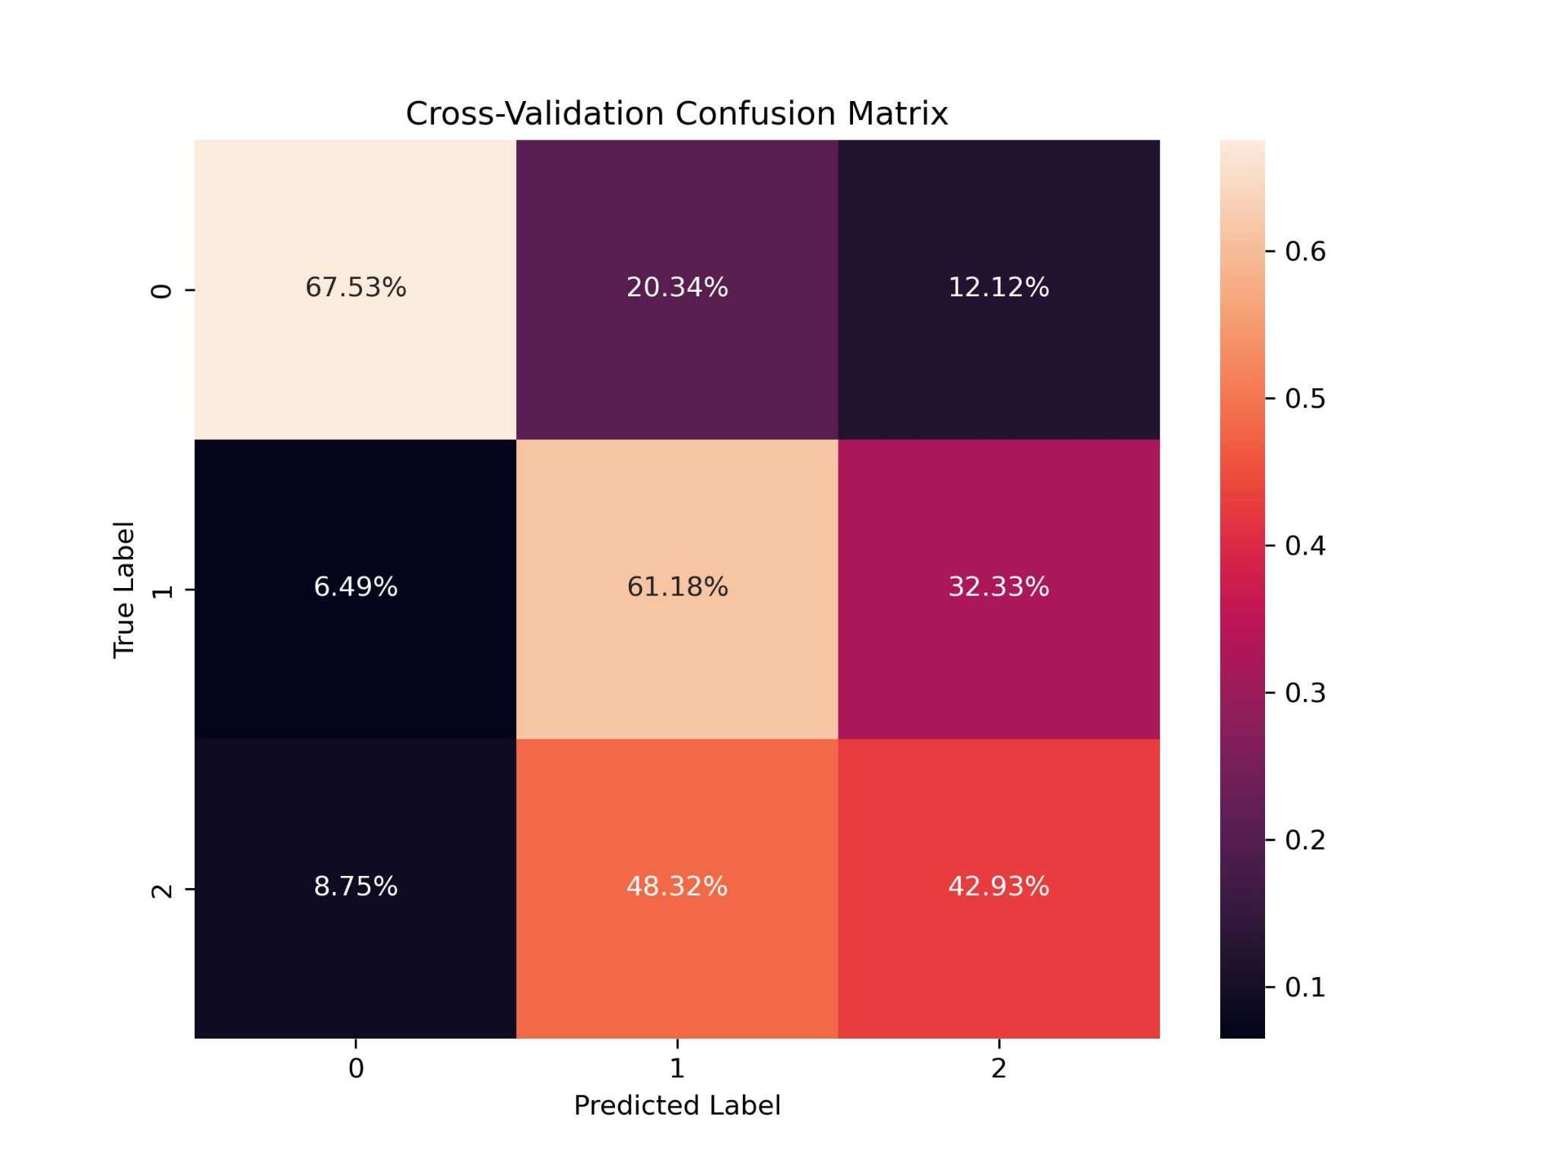
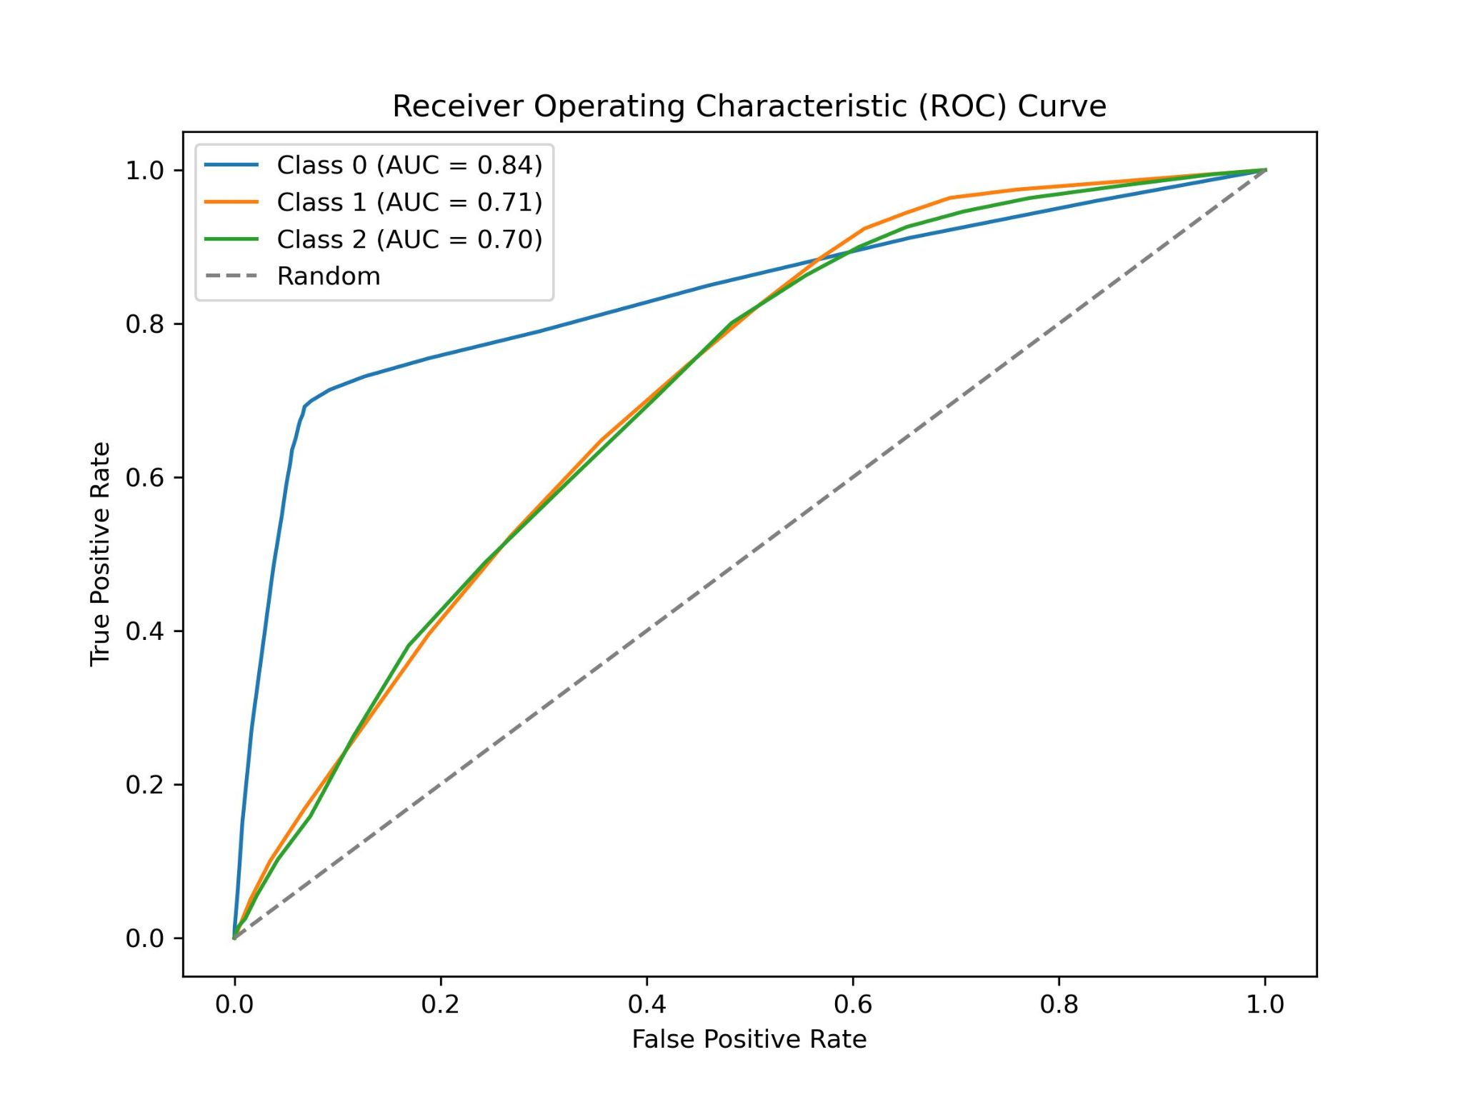
Predictis
Phase 3: Classification
Confusion Matrices and ROC-AUC
Confusion Matrix of KNN Model | ROC of KNN Model
A Medical Decision Making Daignosis System

Slide 42
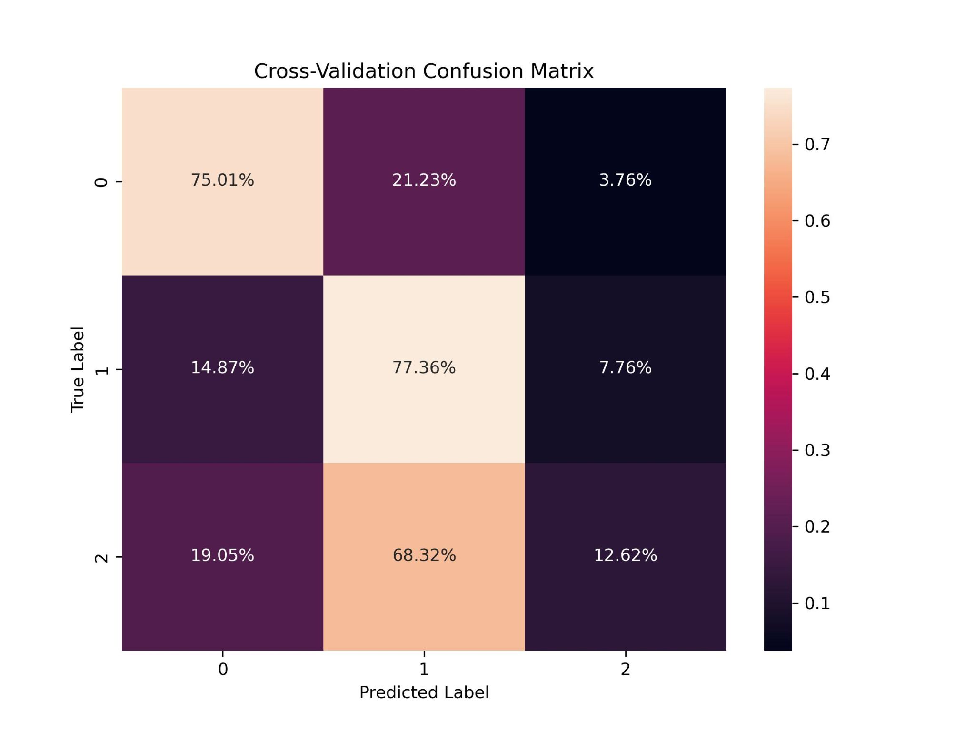
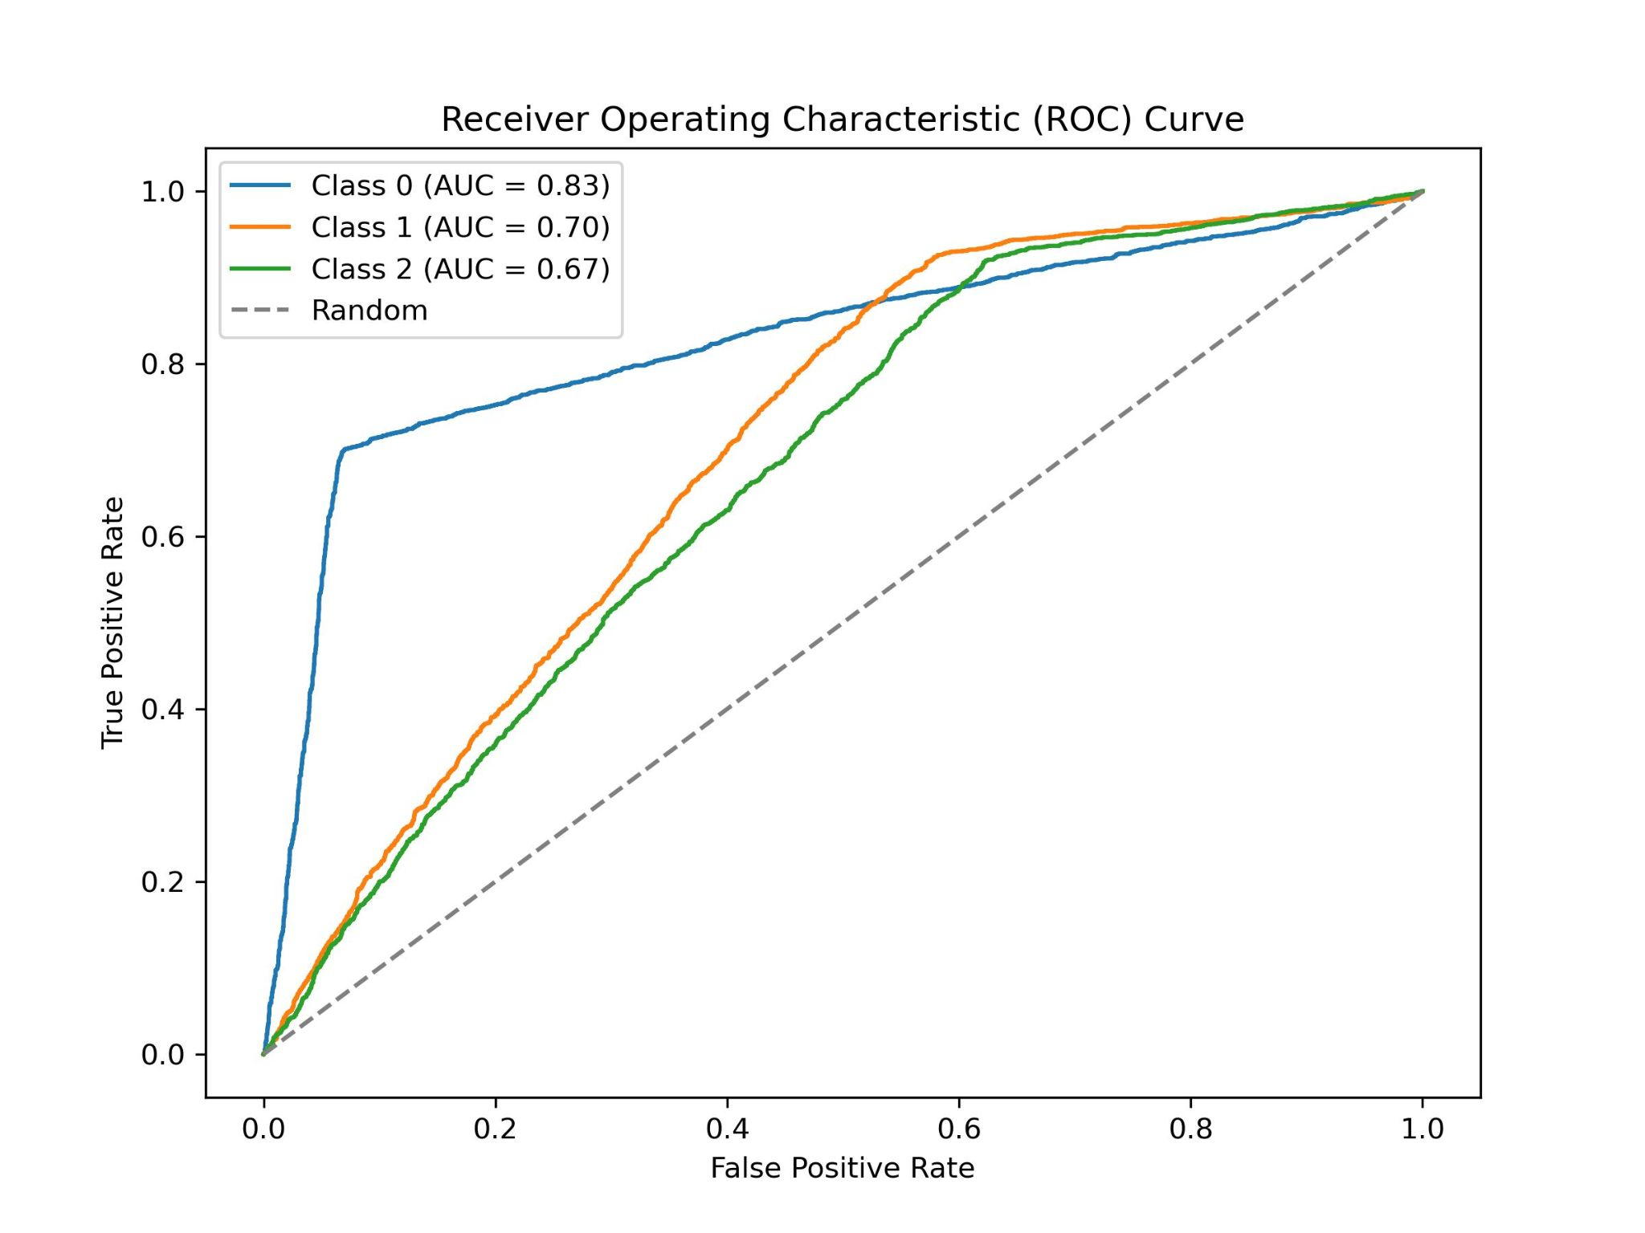
Predictis
Phase 3: Classification
Confusion Matrices and ROC-AUC
Confusion Matrix of NB Model | ROC of NB Model
A Medical Decision Making Daignosis System

Slide 43
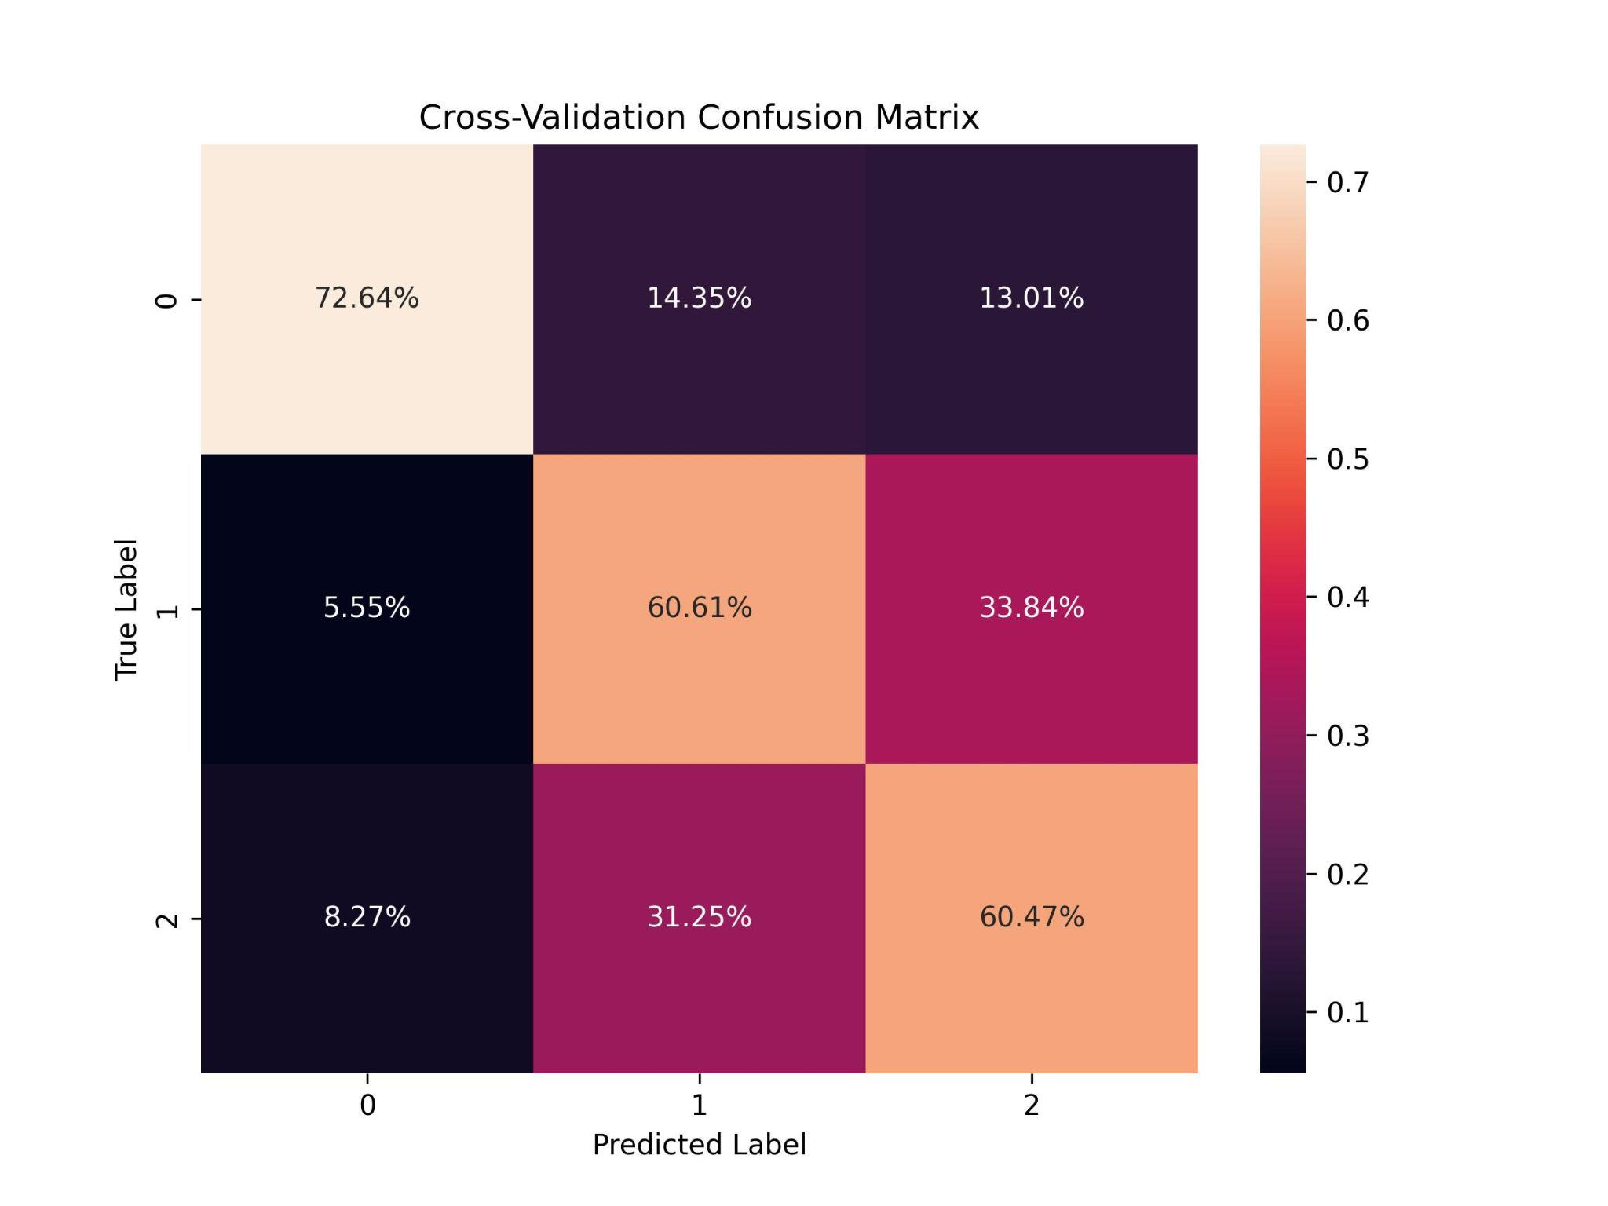
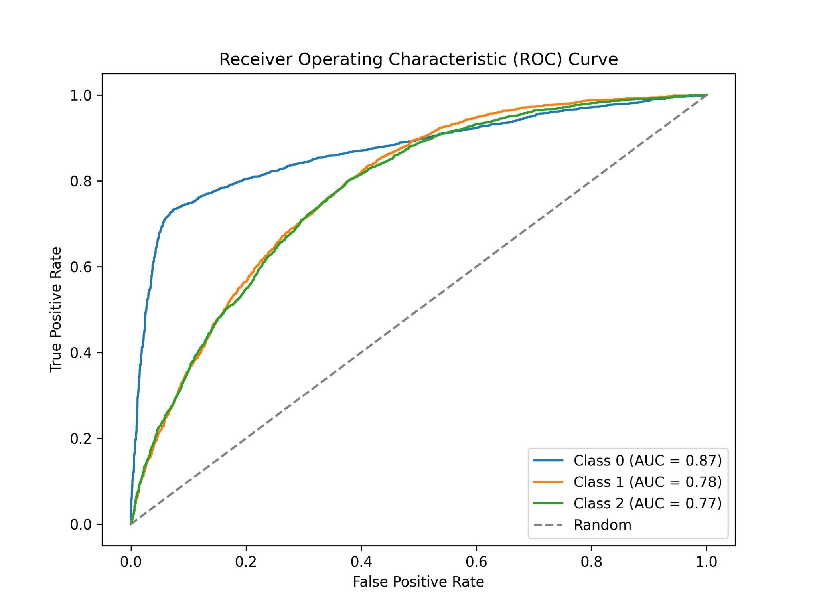
Predictis
Phase 3: Classification
Confusion Matrices and ROC-AUC
Confusion Matrix of Bagging Model | ROC of Bagging Model
A Medical Decision Making Daignosis System

Slide 44
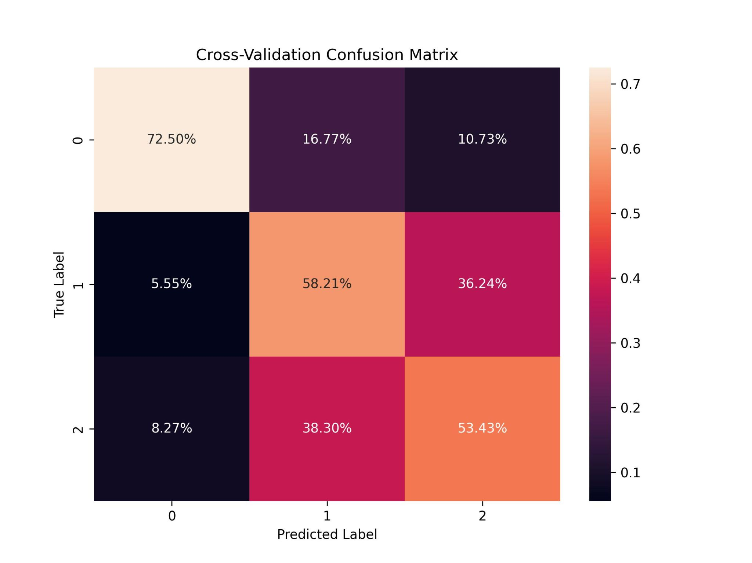
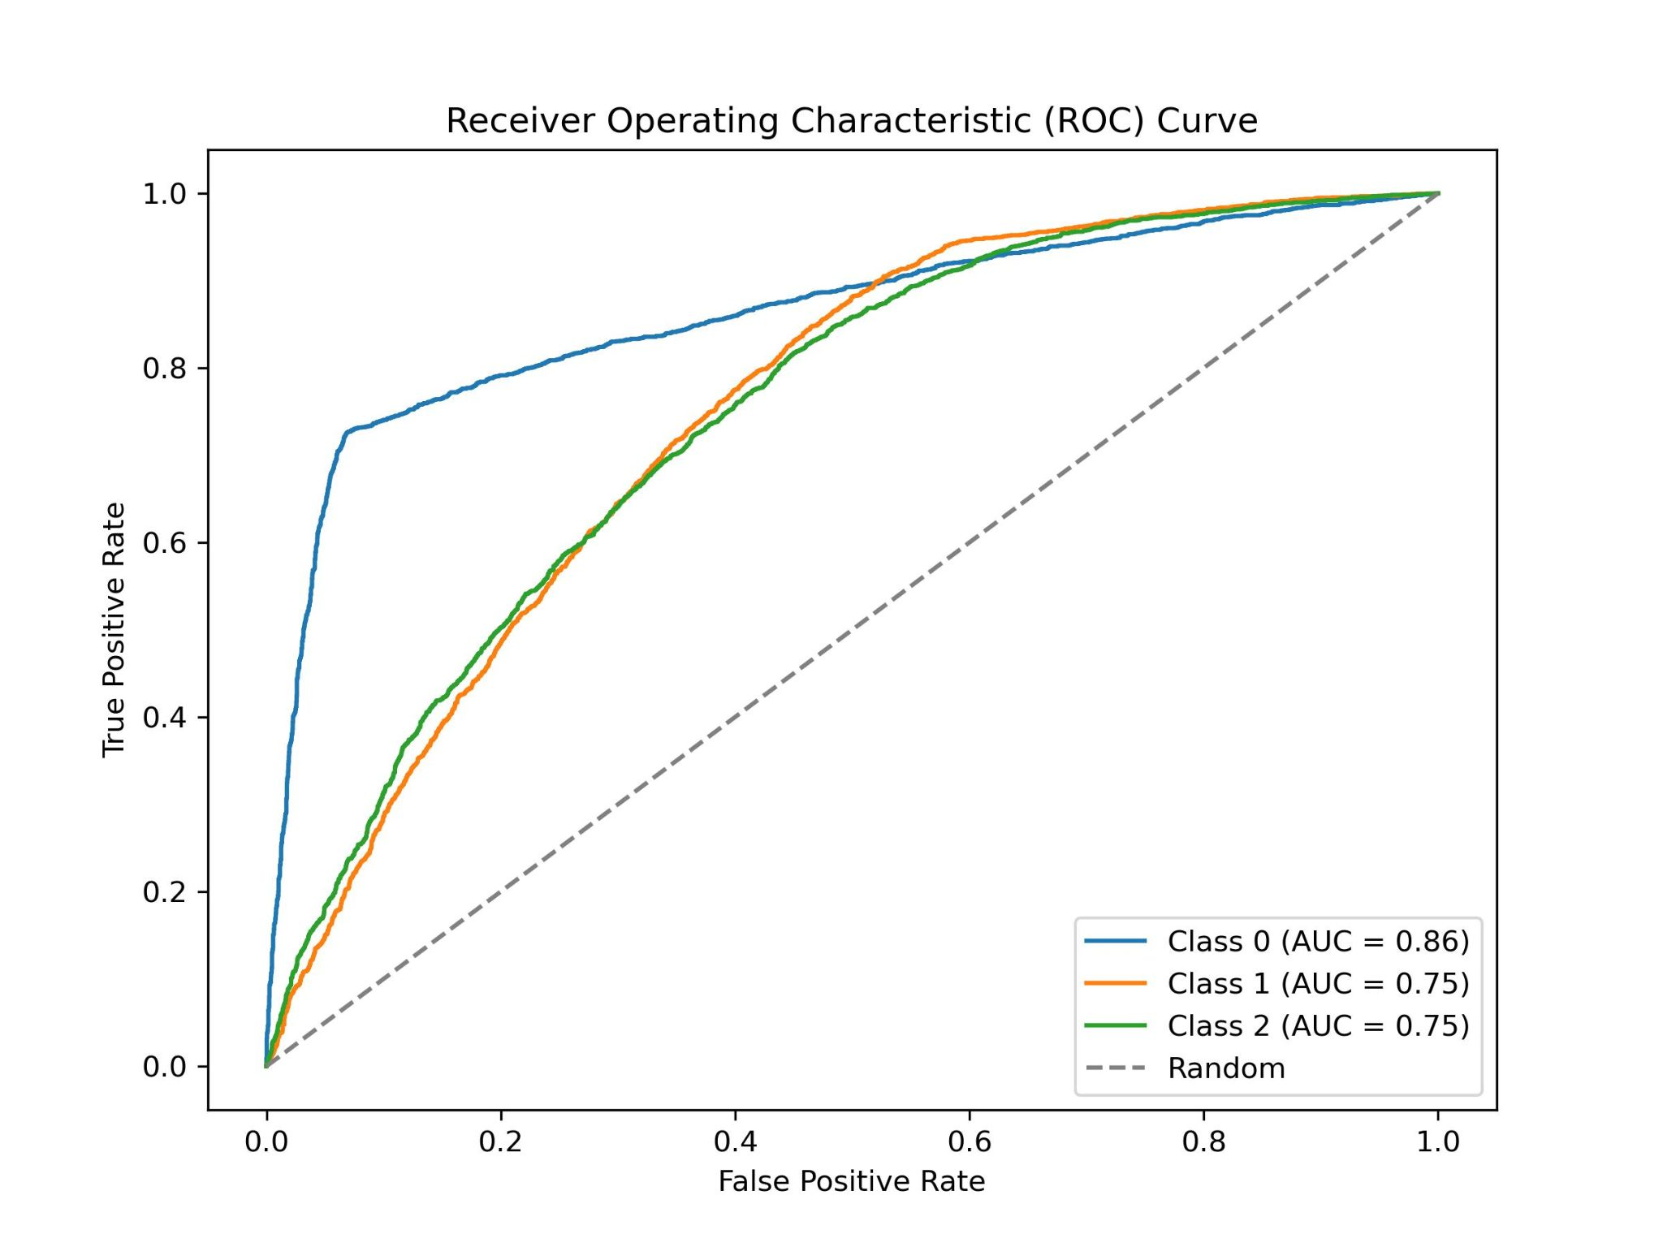
Predictis
Phase 3: Classification
Confusion Matrices and ROC-AUC
Confusion Matrix of RF Model | ROC of RF Model
A Medical Decision Making Daignosis System

Slide 45

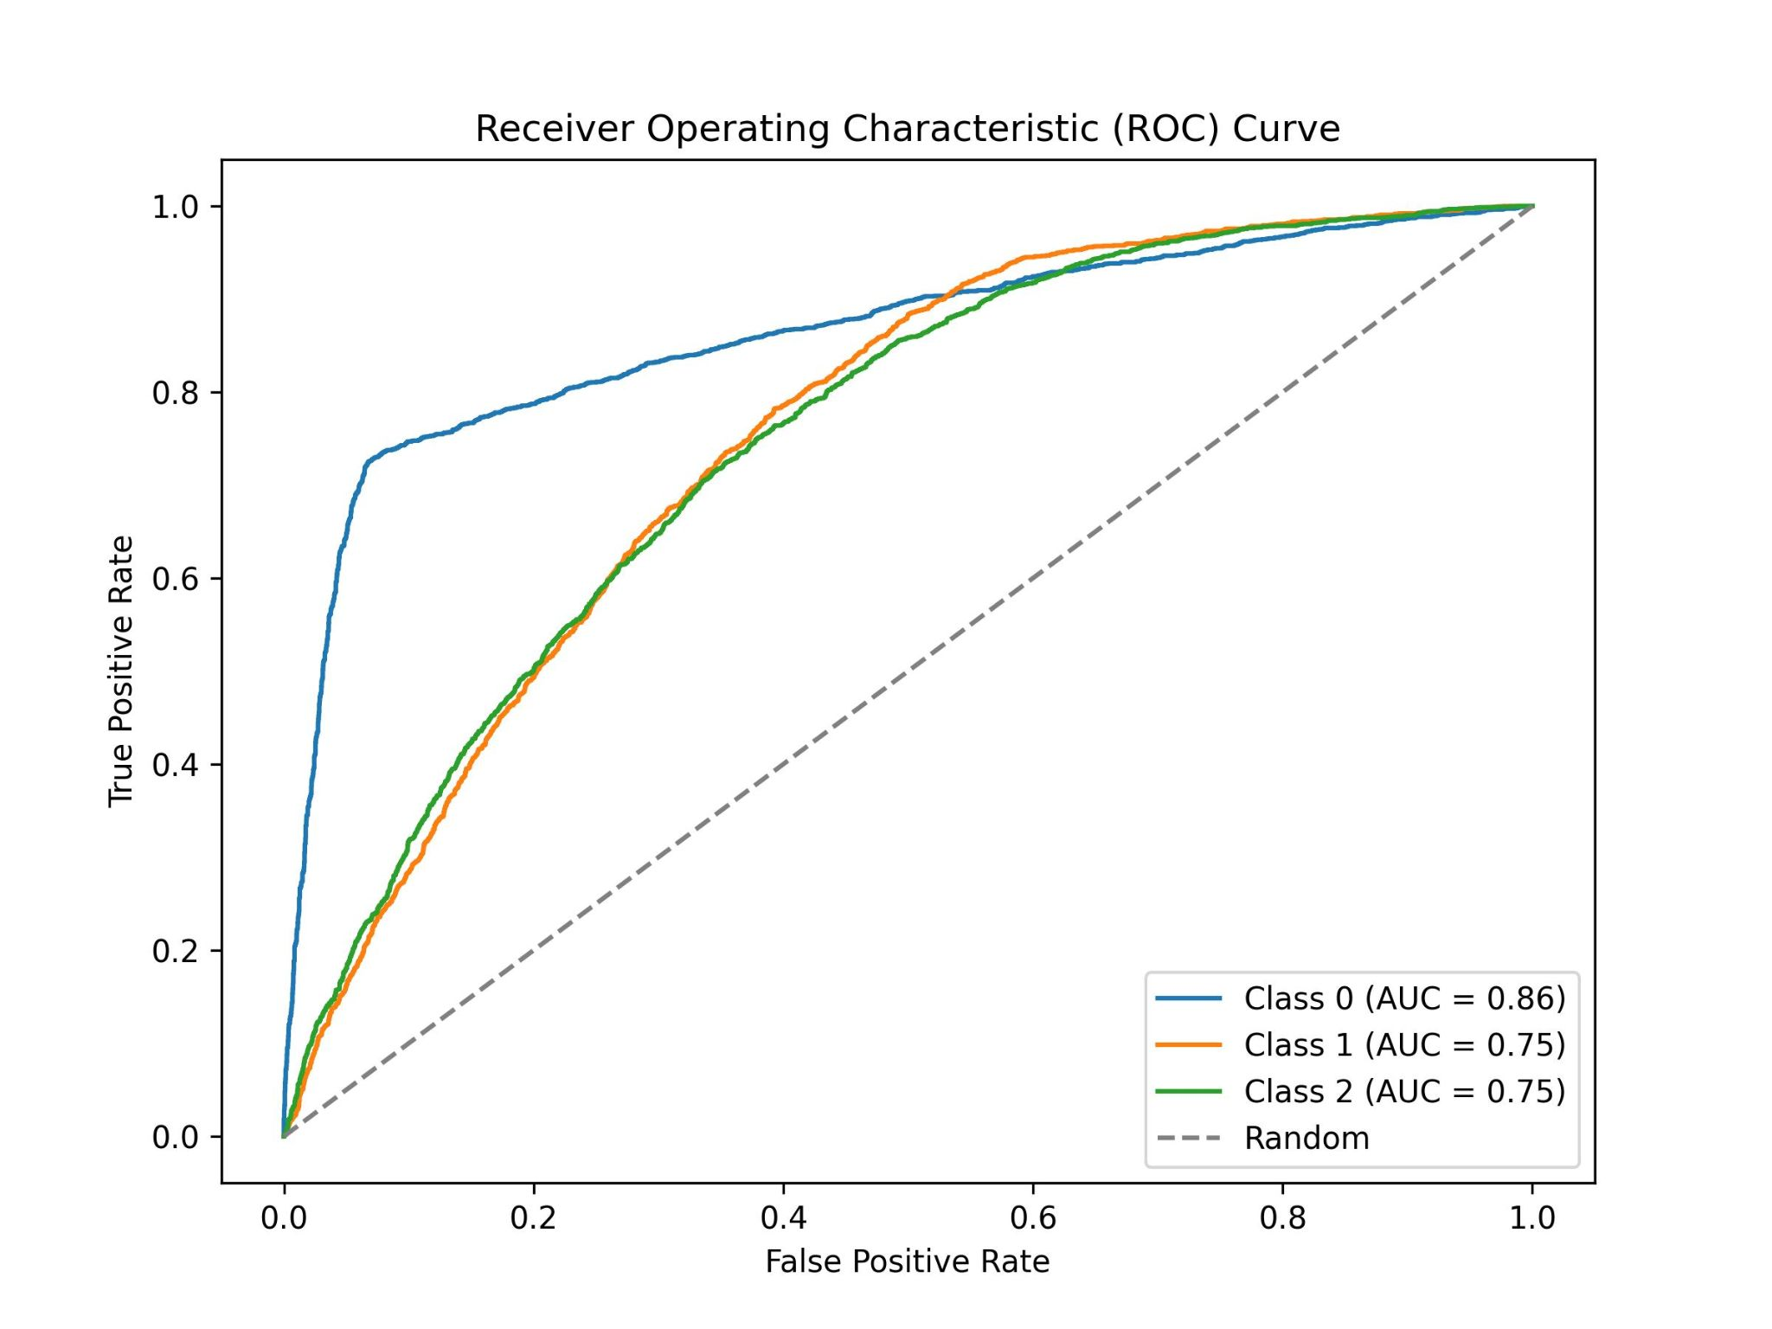
Predictis
Phase 3: Classification
Confusion Matrices and ROC-AUC
Confusion Matrix of XGBoost Model | ROC of XGBoost Model
A Medical Decision Making Daignosis System

Slide 46
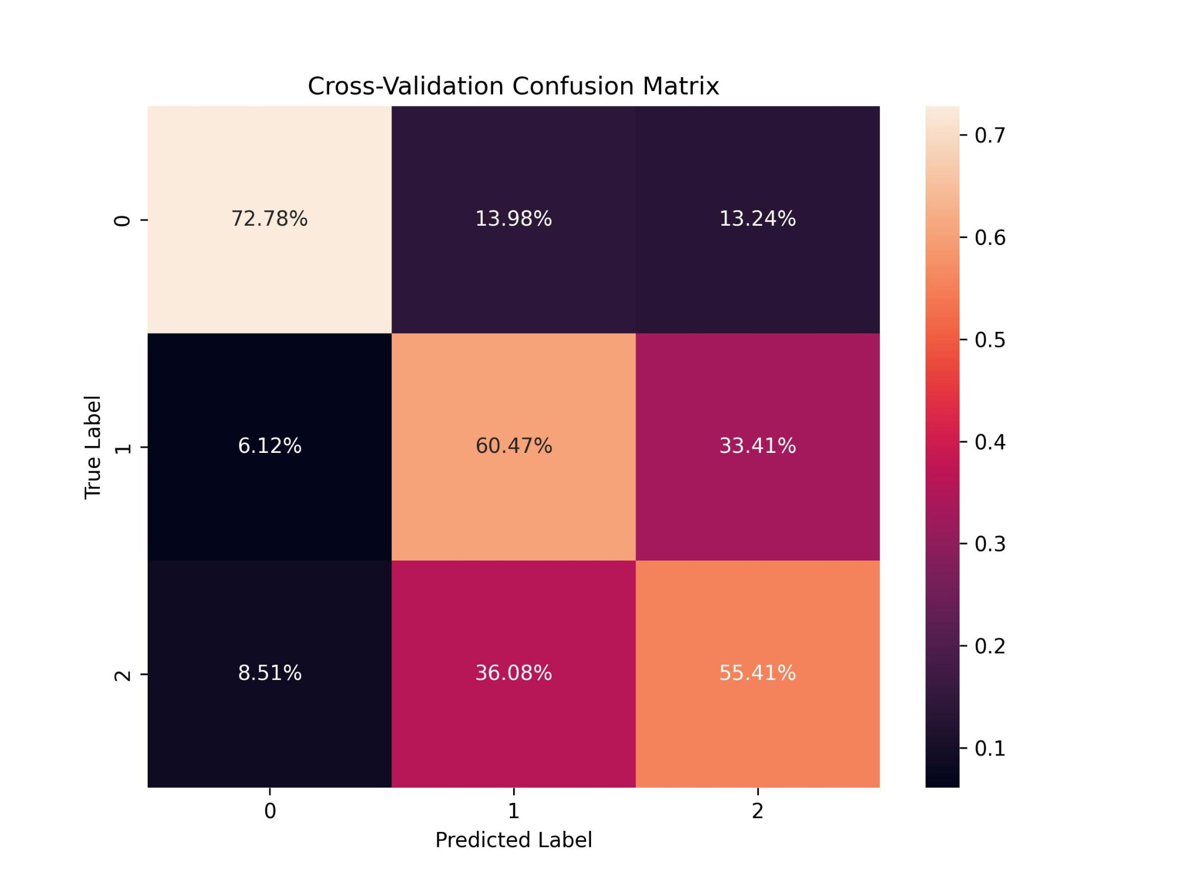
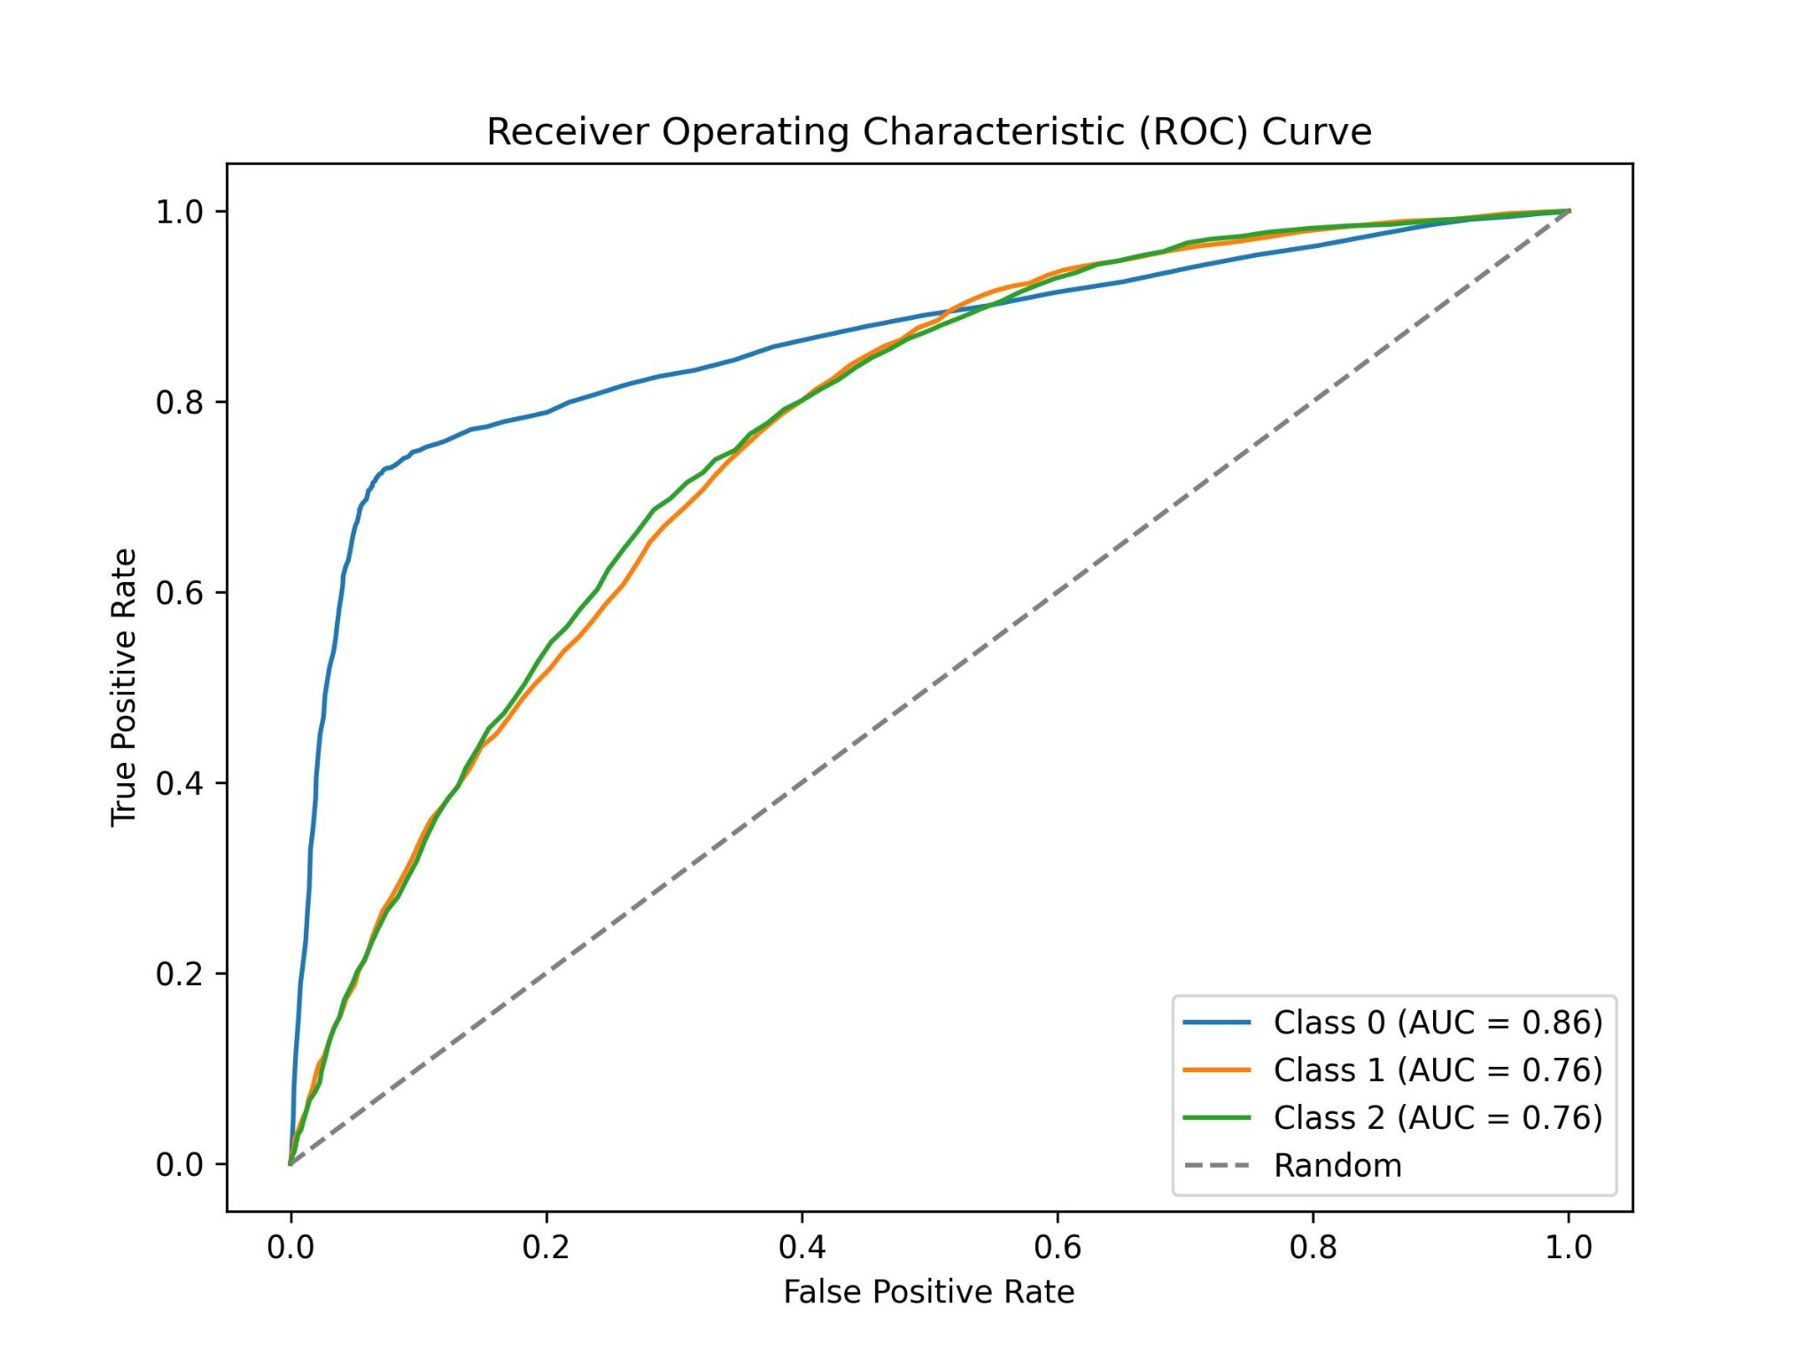
Predictis
Phase 3: Classification
Confusion Matrices and ROC-AUC
Confusion Matrix of Stacking Model | ROC of Stacking Model
A Medical Decision Making Daignosis System

Slide 47

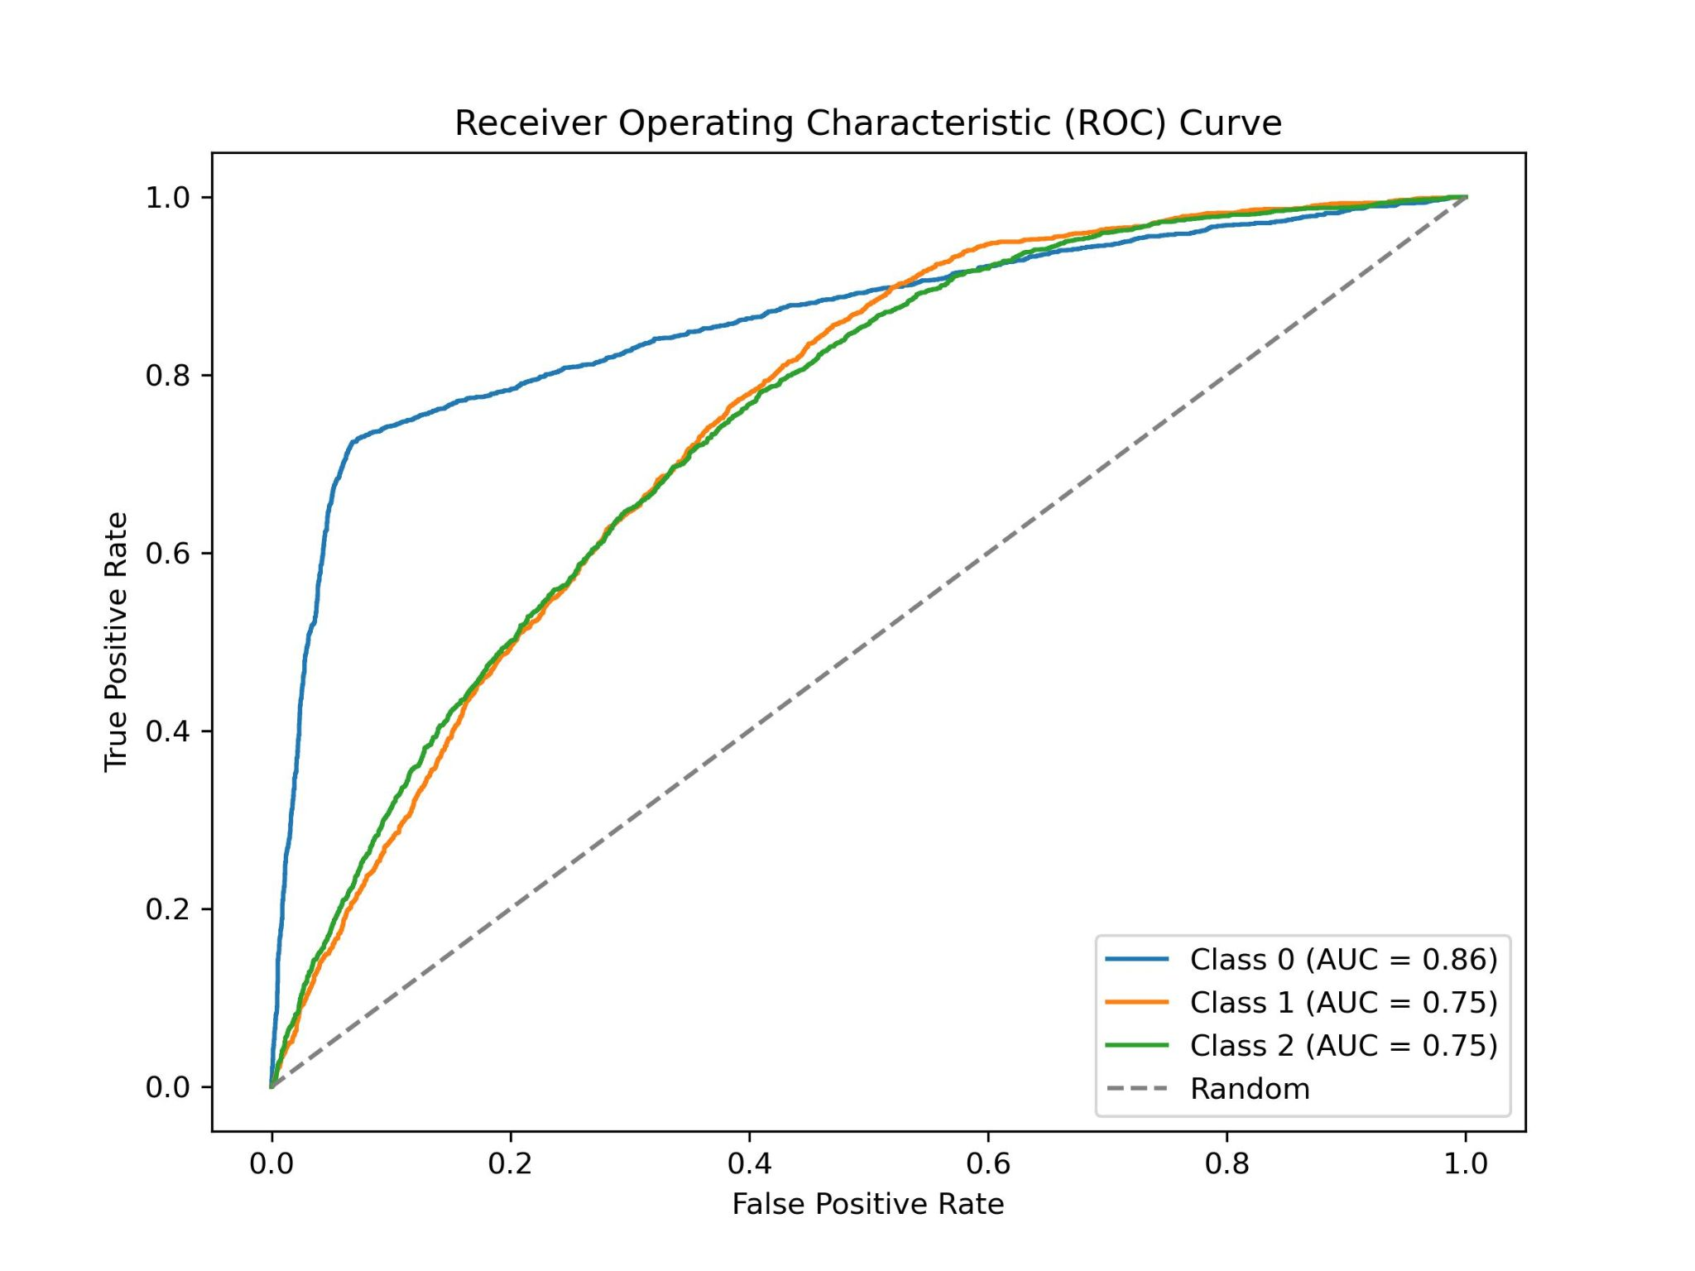
Predictis
Phase 3: Classification
Confusion Matrices and ROC-AUC
Confusion Matrix of MLP Model | ROC of MLP Model
A Medical Decision Making Daignosis System

Slide 48
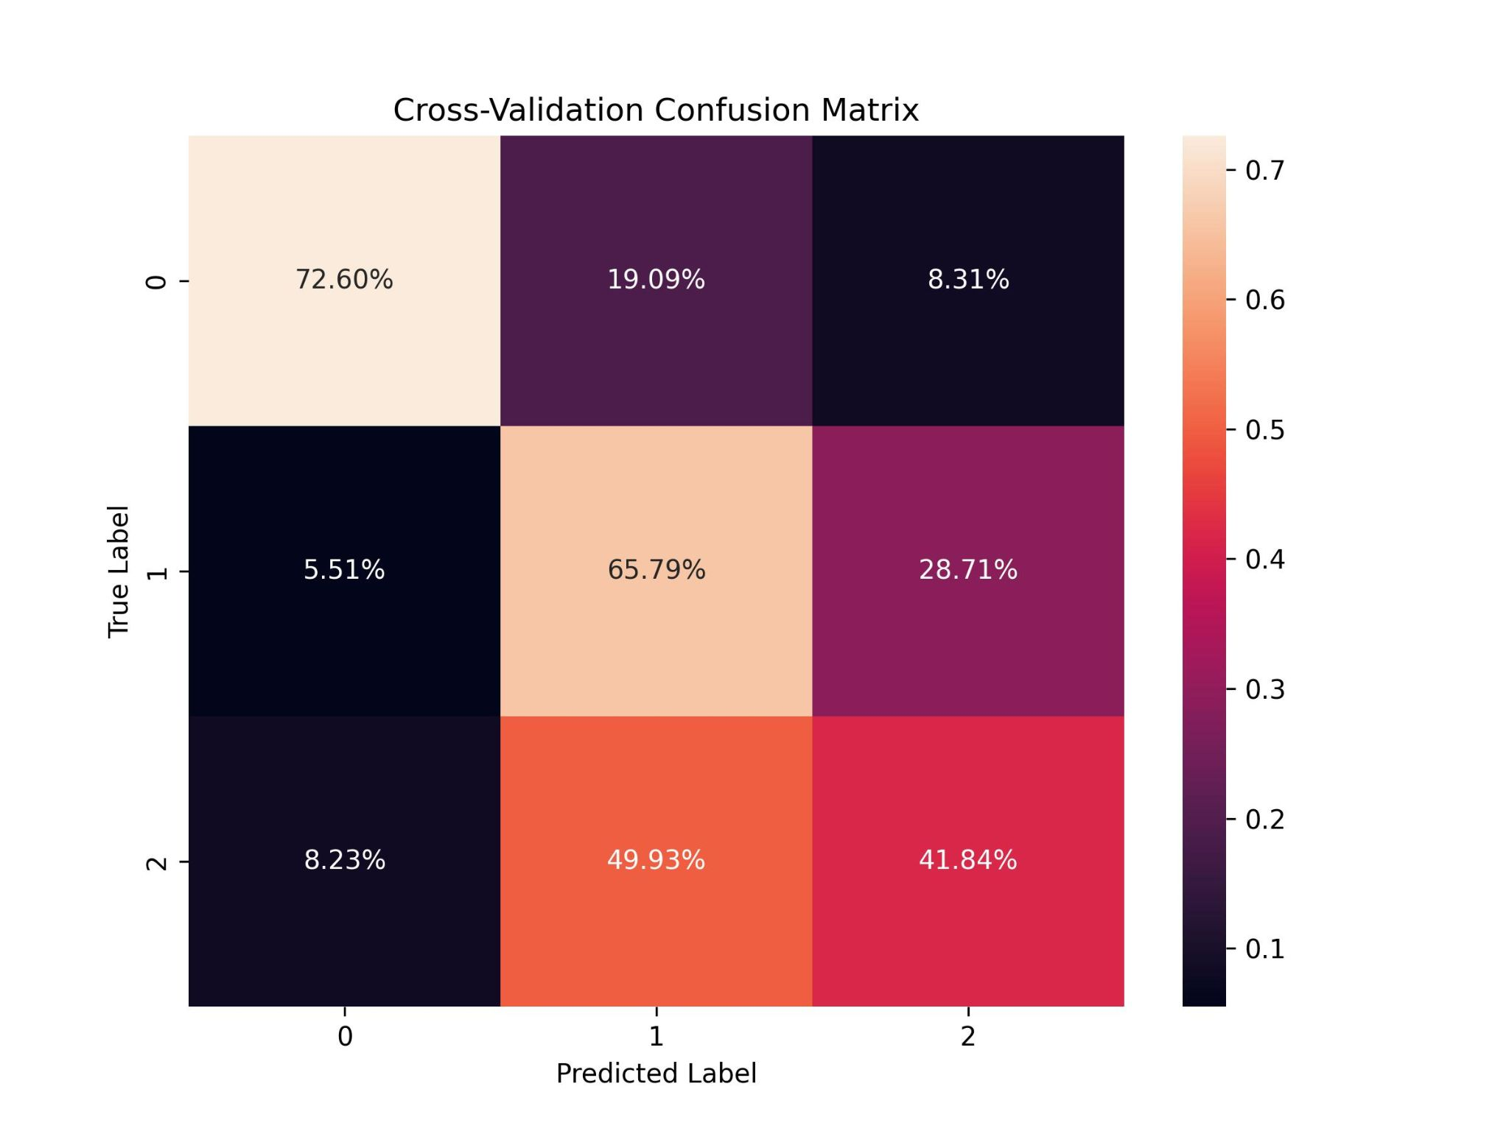
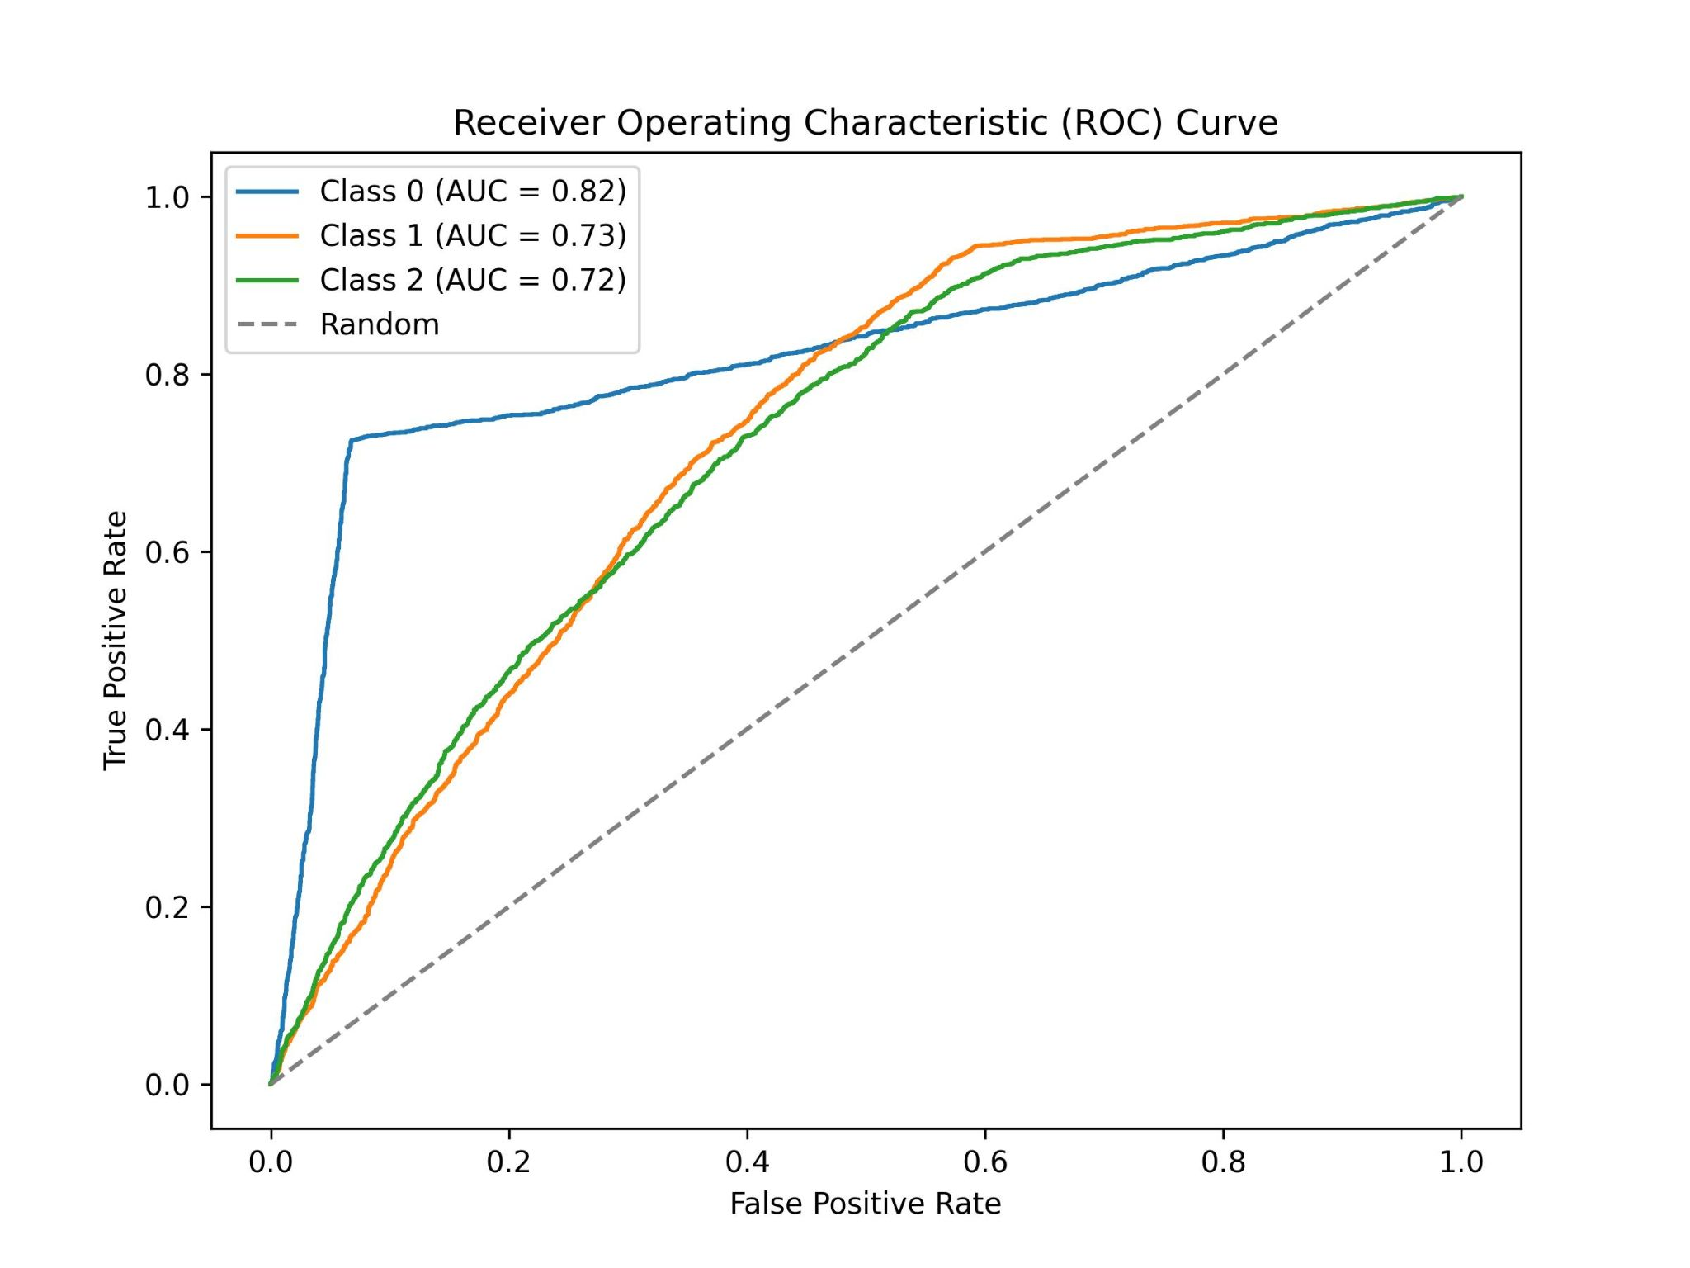
Predictis
Phase 3: Classification
Confusion Matrices and ROC-AUC
Confusion Matrix of SVC Model | ROC of SVC Model
A Medical Decision Making Daignosis System

Slide 49
Predictis
Phase 3: Classification
Class Label Analysis:
Investigated the encoded class labels and associated them with meaningful categories:
Class Label 0: "Never Smoked"
Class Label 1: "Used to Smoke but Quit"
Class Label 2: "Still Smokes"
Recognized varying misclassification rates for each class label.
Observations:
Identified that the misclassification rate for Class Label 0 ("Never Smoked") is lower compared to Class Labels 1 and 2.
Most significant confusion and misclassifications were observed in Class Labels 1 and 2.
A Medical Decision Making Daignosis System

Slide 50
Predictis
Phase 3: Classification
Result Analysis
Bagging emerges as the best-performing model, showcasing top-tier performance in precision, recall, F-score, and Roc Auc.
Random Forest also stands out with high specificity values, emphasizing its ability to correctly identify negative instances.
Stacking, Boosting, and MLP also demonstrate competitive performance across multiple metrics.
Final Declaration:
The best-performing model is Bagging with RF, as it consistently achieves high values across precision, recall, F-score, and Roc AUC, indicating their overall effectiveness in classification tasks.
A Medical Decision Making Daignosis System

Slide 51
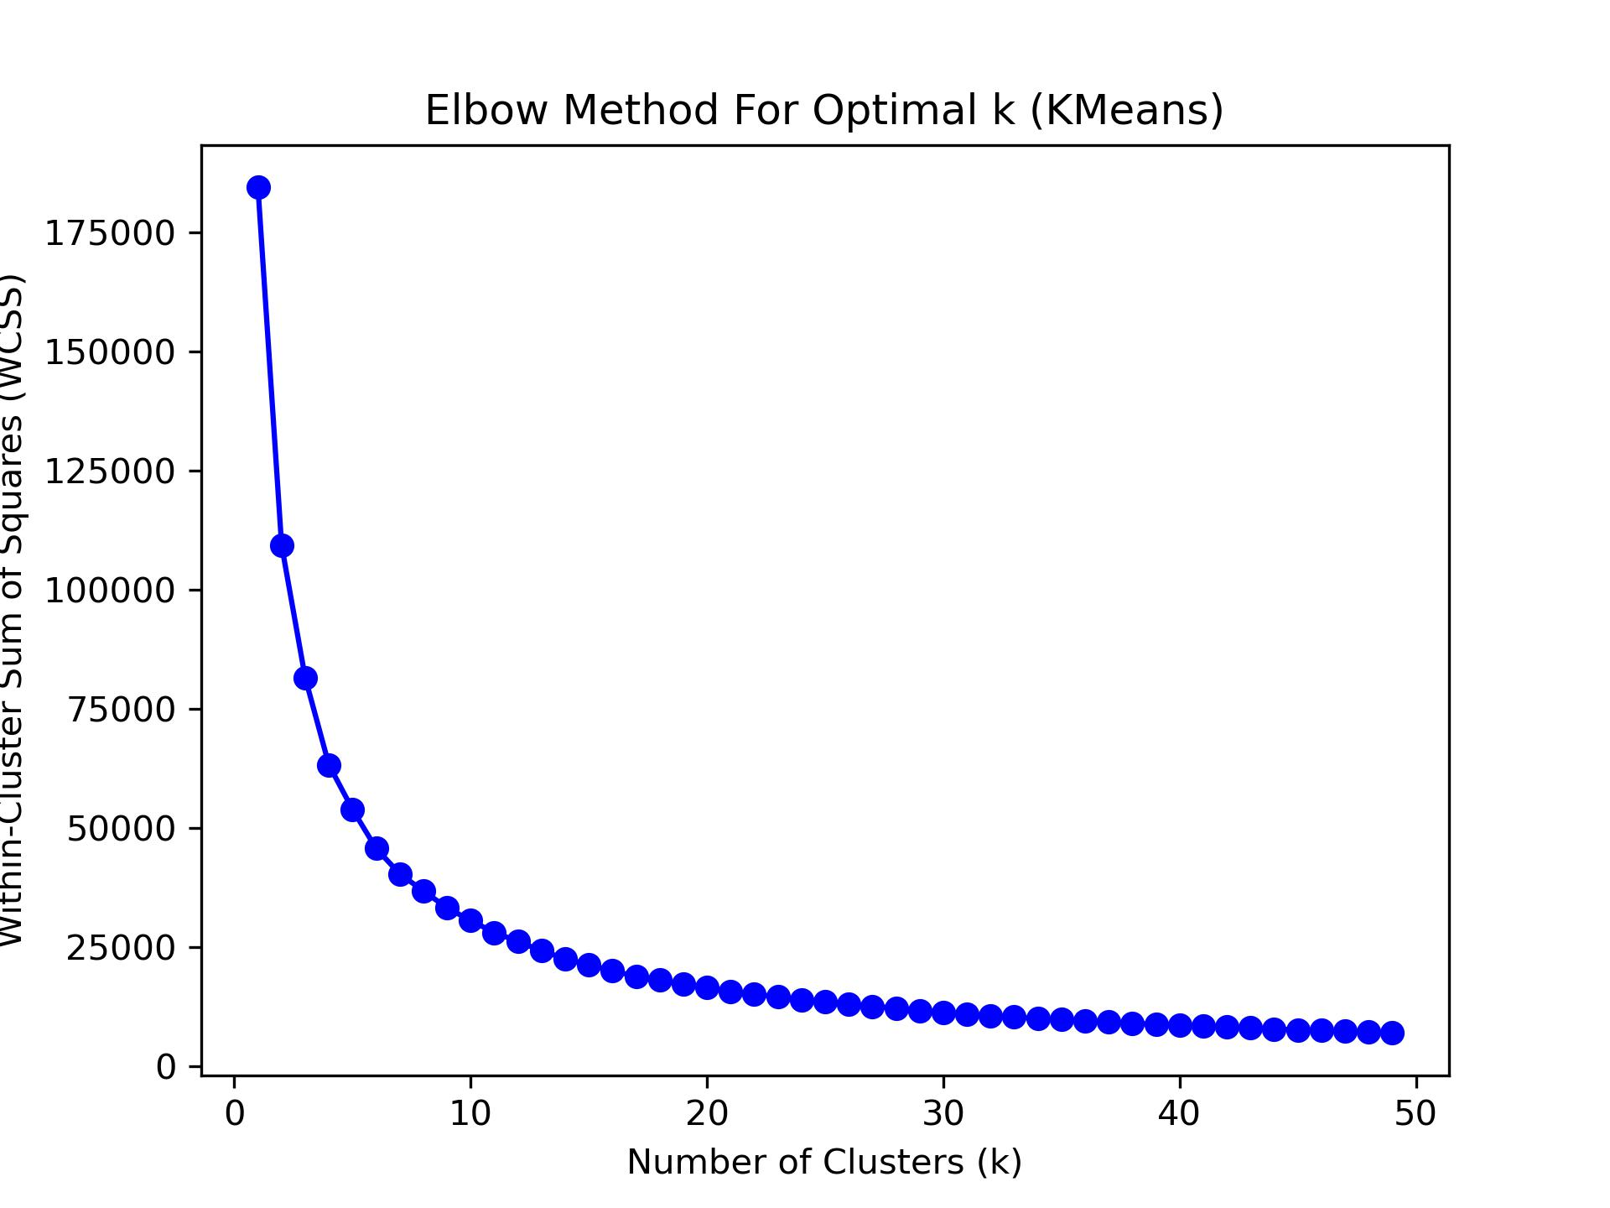
Predictis
Phase 4: Clustering
K Means : Selection of K by Elbow Method
A Medical Decision Making Daignosis System

Slide 52
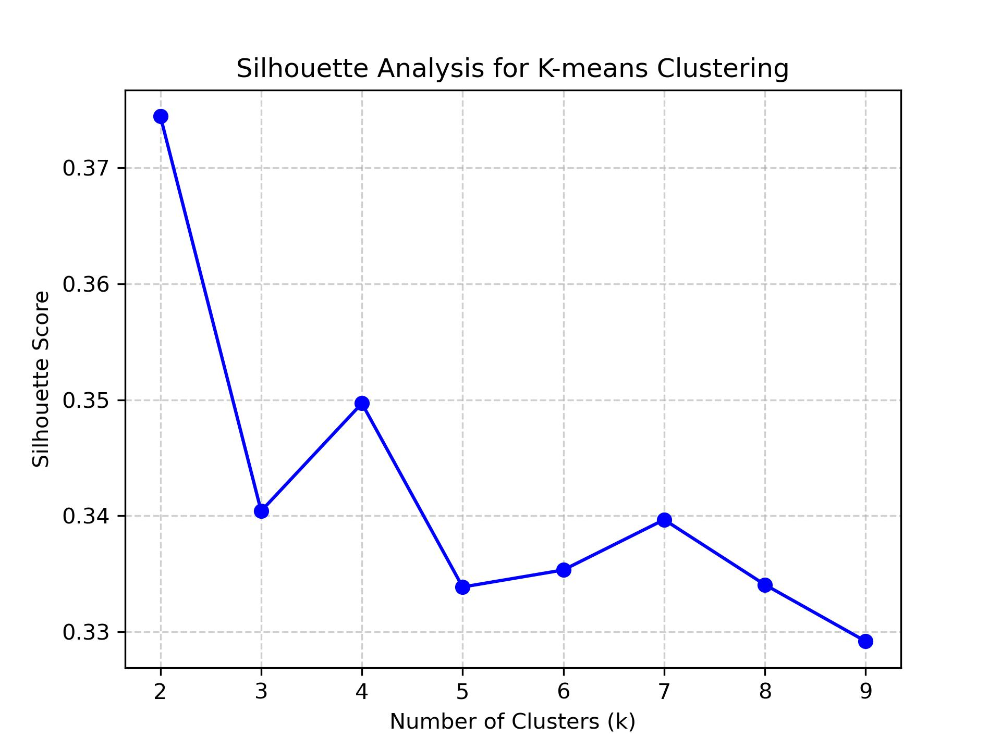
Predictis
Phase 4: Clustering
K Means : Silhouette Analysis
A Medical Decision Making Daignosis System

Slide 53
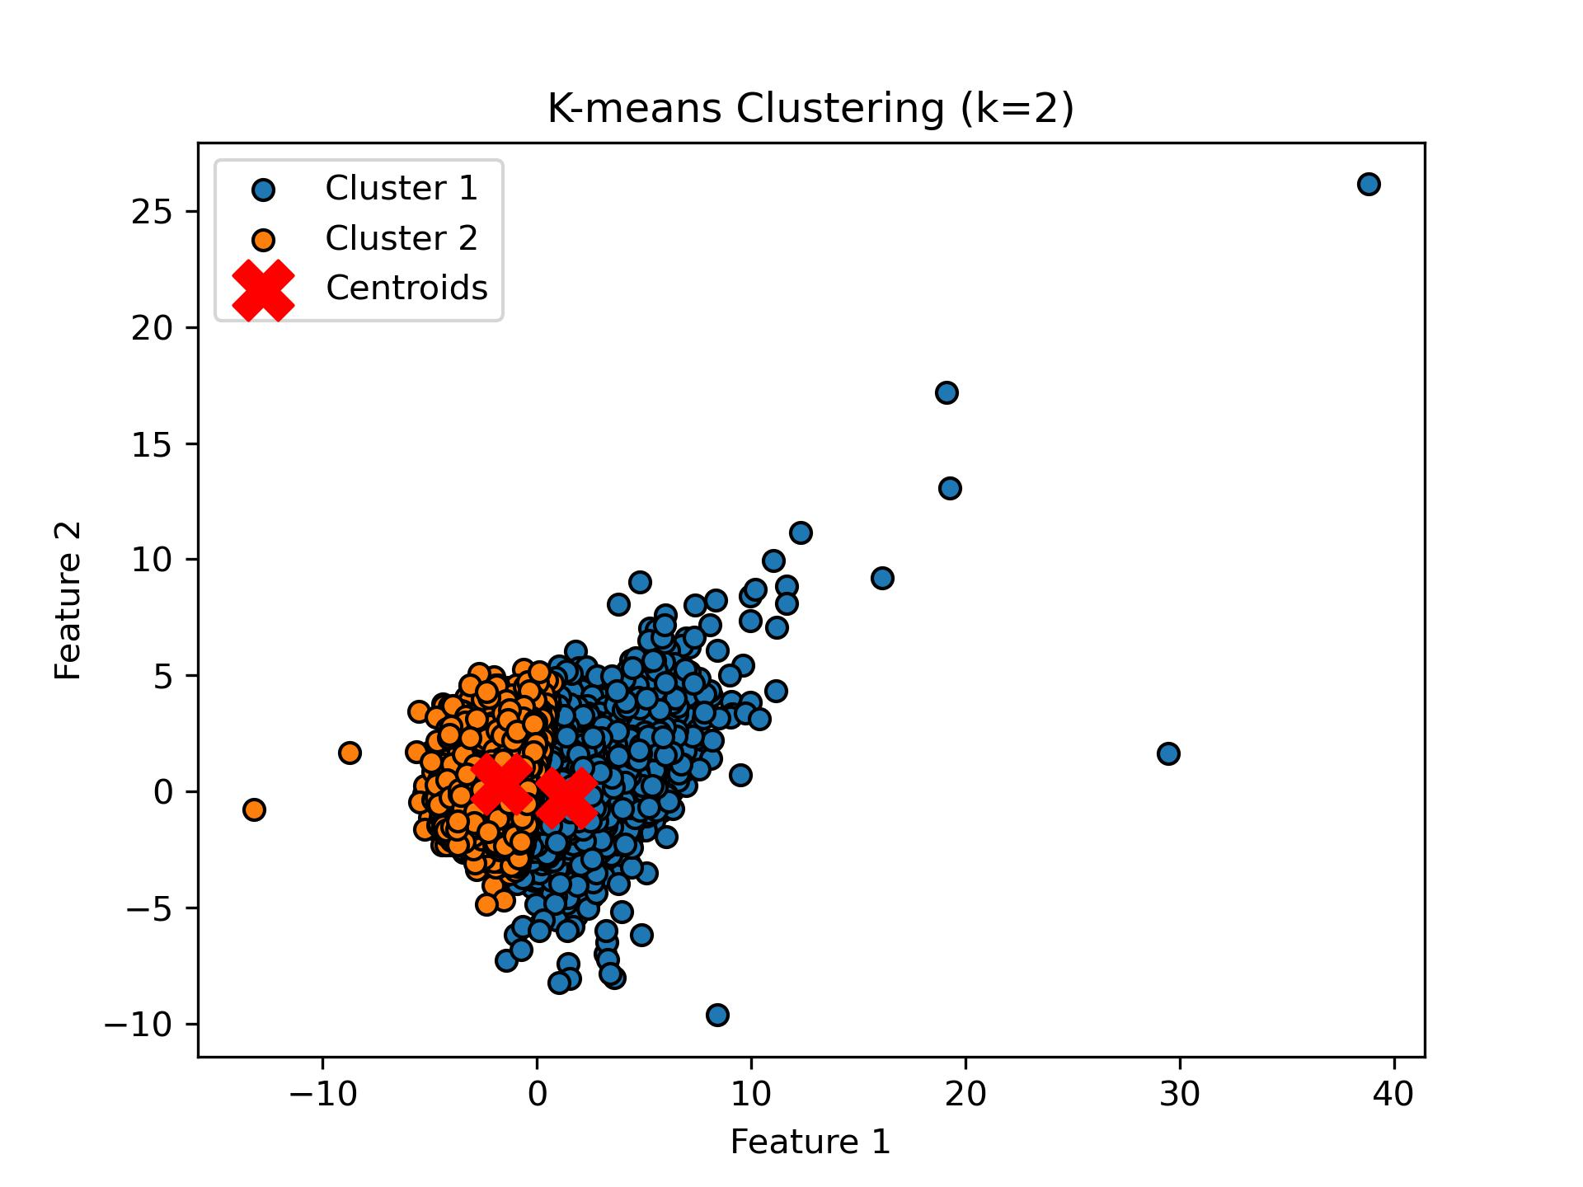
Predictis
Phase 4: Clustering
K Means : Clusters for K=2
A Medical Decision Making Daignosis System

Slide 54
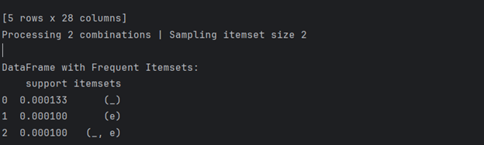
Predictis
Phase 4: Clustering
Apriori Algorithm:
A Medical Decision Making Daignosis System

Slide 55
Predictis
Phase 4: Clustering
Apriori Algorithm:
A Medical Decision Making Daignosis System

Slide 56
Predictis
Phase 4: Clustering
Apriori Algorithm:
Antecedents and Consequents:
Rule 1: If (e) is present, then (_) is also present.
Rule 2: If (_) is present, there is a 75% chance that (e) is also present.
Support and Confidence:
Antecedent Support and Consequent Support: The support of (e) is 0.01%, and (_) is 0.0133%.
Support: The combined support of both (e) and (_) is 0.01%.
Confidence: Rule 1 has 100% confidence, indicating that whenever (e) is present, (_) is also present. Rule 2 has 75% confidence, suggesting that (_) is present when (e) is present.
A Medical Decision Making Daignosis System

Slide 57
Predictis
Conclusion
Phase 1:
The dataset has anomalies and multicollinearity, which has been addressed by the z-score method and the VIF.
Of the three methods of Variable Transformation, standardization has been chosen for all tasks.
Of the dimensionality reduction techniques Random Forest Feature Importance is preferred.
Phase 2:
The Backward Stepwise Regression selects the final features for the regression task.
The F-test and T-test testify the model’s statistical significance.
The Results are: R-square:64.68 Adjusted R-Square: 64.67 MSE:202.97
A Medical Decision Making Daignosis System

Slide 58
Predictis
Conclusion
Phase 3:
The Bagging with RF proves to be better classifier with an F1-score of 0.6508
Phase 4:
The KMeans can separate the data in 2 clusters.
The Apriori algorithm identifies two frequent itemsets, denoted by (_), (e), and (_,e) and the extracted rules indicates strong associations between items (antecedents) and their consequents.
A Medical Decision Making Daignosis System

Slide 59
Predictis
Recommendation & Future Work
Advanced Feature Engineering:
Exploring additional features or refining existing ones, especially focusing on discriminatory power for challenging classes (Class Labels 1 and 2).
Incorporating domain knowledge to identify novel features that might enhance the model's ability to capture complex patterns.
Data Augmentation Strategies:
Augmenting the dataset, particularly with more instances of challenging classes (Class Labels 1 and 2), to improve the model's ability to generalize and reduce misclassifications.
Exploring data synthesis methods or techniques that generate realistic instances of underrepresented classes.
A Medical Decision Making Daignosis System

Slide 60
Predictis
Recommendation & Future Work
3. Advanced Model Exploration:
Investigating the application of advanced machine learning models, such as deep learning architectures (e.g., neural networks), to ascertain whether complex relationships can be better captured.
Experimenting with ensemble techniques or novel algorithms that might provide improvements in model performance and robustness.
A Medical Decision Making Daignosis System

Slide 61
Predictis
Thank You !!
A Medical Decision Making Daignosis System

